Slide 1

Research project on using AI to improve English
Mr. Lee Kwan Hung, Ray

Slide 2
My Portfolios
Lee Kwan Hung, Ray
Duty: Academic Team Coordinator, ICT Teacher
Research Interests
  AI in Education
  Motivation
    Metaverse
    Gamify in Education
  STEM+ Education

Slide 3
Content
Background and Introduction to the Project
Implementation Strategy
Data Analysis
Next Steps

Slide 4
Participating Teachers
Mr Lee Kwan Hung, Ray (Observer, ICT teacher)
Ms Lui Wing Sze (English teacher)
Ms Yeung Tsing Huen (English teacher)

Slide 5
Background

Slide 6
Background
School in Tung Chung
We aim to achieve a higher University admission rate
-> Improving students' English proficiency may be one
effective method.

Slide 7
Background
Cat. 1: High learning motivation, English proficiency level qualified (15 students [~13%])
Cat. 2: Low learning motivation, English proficiency level qualified (15 students [~13%])
Cat. 3: High learning motivation, English proficiency level unqualified (45 students [~36%])
Cat. 4: Low learning motivation, English proficiency level unqualified (50 students [~38%])
*English proficiency level qualified: DSE Level 2

Slide 8
Background - Current strategies
Cultivate an English atmosphere in the school.
  Students can study/play with English teachers in the English corner.
  Organising interest classes on different topics, such as English handicrafts
  Having English film appreciation
  Book recommendations
  Spelling games
Increase students‘ exposure to English and broaden their horizons
  By participating in extracurricular activities and competitions, such as taking students to watch English dramas, joint school English mock oral exams, etc.
  Reading scheme
Cater for students' learning diversity.
  Adjusting the content of courses for different ability classes
  Different levels of Test and exam papers
  After-school remedial classes

Slide 9
Background - Evaluate current strategies
Based on data from internal tests and exams, as well as TSA and DSE, our current school strategy is effective for Categories 1 and 2, but not for other categories.
Cat. 1: High learning motivation, English proficiency level qualified (15 students [~13%])
Cat. 2: Low learning motivation, English proficiency level qualified (15 students [~13%])

Slide 10
Background
Does a good English environment improve students' English ability?

Slide 11
Background
Traditional way: More exercise!!! More tutorial classes!!!
English Panel: Our workload is very HEAVY.
Can AI help? → Teachers use less or the same amount of time to let students do more exercises, and during this process, students can learn.

Slide 12
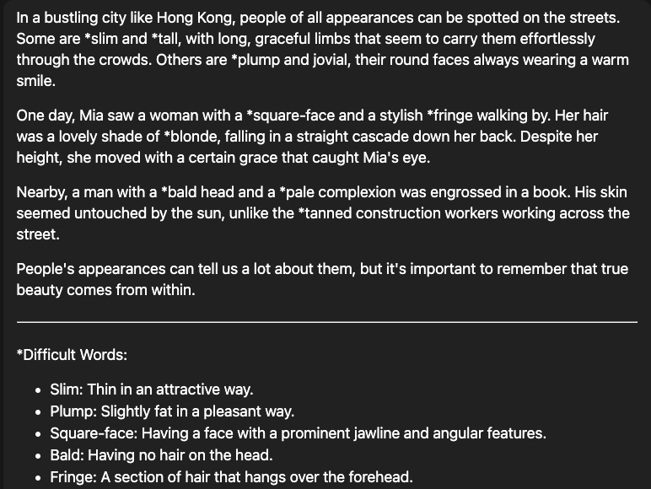
Background
Try ChatGPT by using the following prompt:
You are a Form 1 English teacher. You need to create a 200-word reading passage for the students. The passage should include the following words and use the following theme.
Theme: Describing people's appearance
Word:appearance,slim,plump,squareface,bald,fringe,blonde,straight,tall,pale,tanned
Please highlight the difficult words for Hong Kong Form 1 students in the passage and the words provided by adding * to the word and giving the meaning of those words at the end of the reading passage.

Slide 13
Background
Does it work?
From ChatGPT -> Tailor-made platform

Slide 14

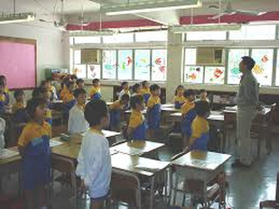
Will learning become……
https://images.app.goo.gl/PP9FSvD69cFzMmgN9
Idea by Ray
Generated by 即梦AI

Slide 15
Background
S1C & S1E (elite classes)
S1C:28 students with 3 NCS students
S1E:28 students with 4 NCS students
Lack of confidence in reading and writing
Poor vocabulary → Weak reading comprehension skills, lack of topic vocabulary for writing

Slide 16
Implementation Strategy

Slide 17
Implementation Strategy
- Objectives
Having a habit of SDL
Improving students’ English
Improving students’ self-efficacy in English
Reducing teachers’ workload and pressure

Slide 18
Implementation Strategy
1
Professional development workshops for teachers
Teaching teachers how to use AI systems
Teaching teachers how to write a prompt
Experience sharing after teachers use it
Participate in joint school-sharing activities to exchange ideas with teachers from different schools.

Slide 19
Implementation Strategy
2
Teaching students to use AI to assist with writing
(ICT lessons)
• Understanding that the articles generated by AI systems can be detected.
• Teaching students to use to get more relevant content by using prompting engineering.

Slide 20
Implementation Strategy
3
Using the AI system to improve students' English vocabulary
Teachers generate reading comprehension exercises using AI every week.
Teachers choose words and sentence patterns they want students to learn from recent textbook topics.

Slide 21
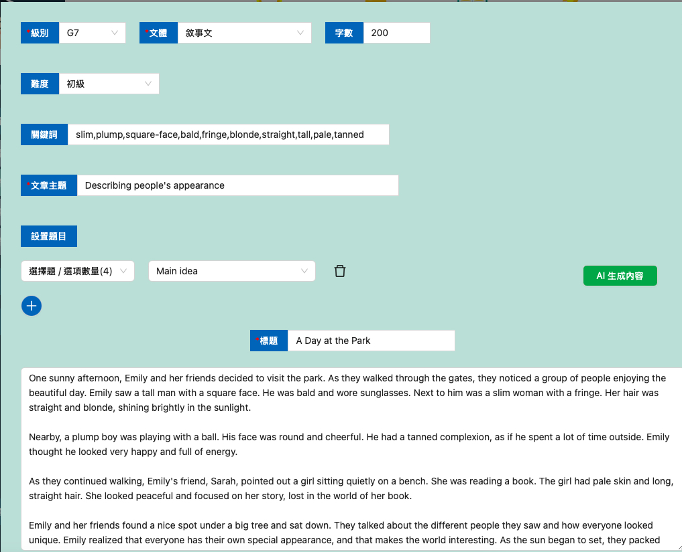
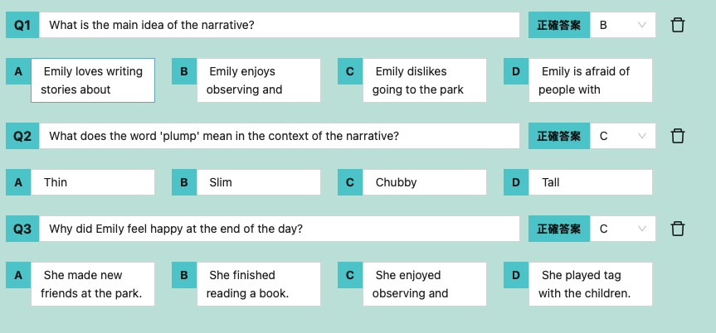

Slide 22
Implementation Strategy
3
Using the AI system to improve students' English vocabulary (After school)
Students need to complete the reading comprehension exercise every week
Students must identify words they do not understand in the relevant article and write them along with their meanings in their English notebooks.

Slide 23
Implementation Strategy
Reading comprehension:
Short Reading Exercise 1
On tailor-made system
(week 1)
Reading comprehension of
the target text from textbook
(week 2)
Short Reading Exercise 2
On tailor-made system
(week 3)
Supplementary reading comprehension on the same theme
(week 4)
Like a pre-reading exercise to familiarize target vocab
Like a pre-reading exercise to familiarize target vocab
Taken target vocab from textbook to generate reading exercise on tailor-made system
Taken target vocab from supplementary reading comprehension to generate reading exercise on tailor-made system

Slide 24
Implementation Strategy
4
Enhancing students' writing skills with the aid of an AI system. (After school)
Each weekmonth, students must write a 200100-word article on a specific topic using vocabulary from the English vocabulary book.
After finishing the writing task, the students should upload it to the AI system.

Slide 25
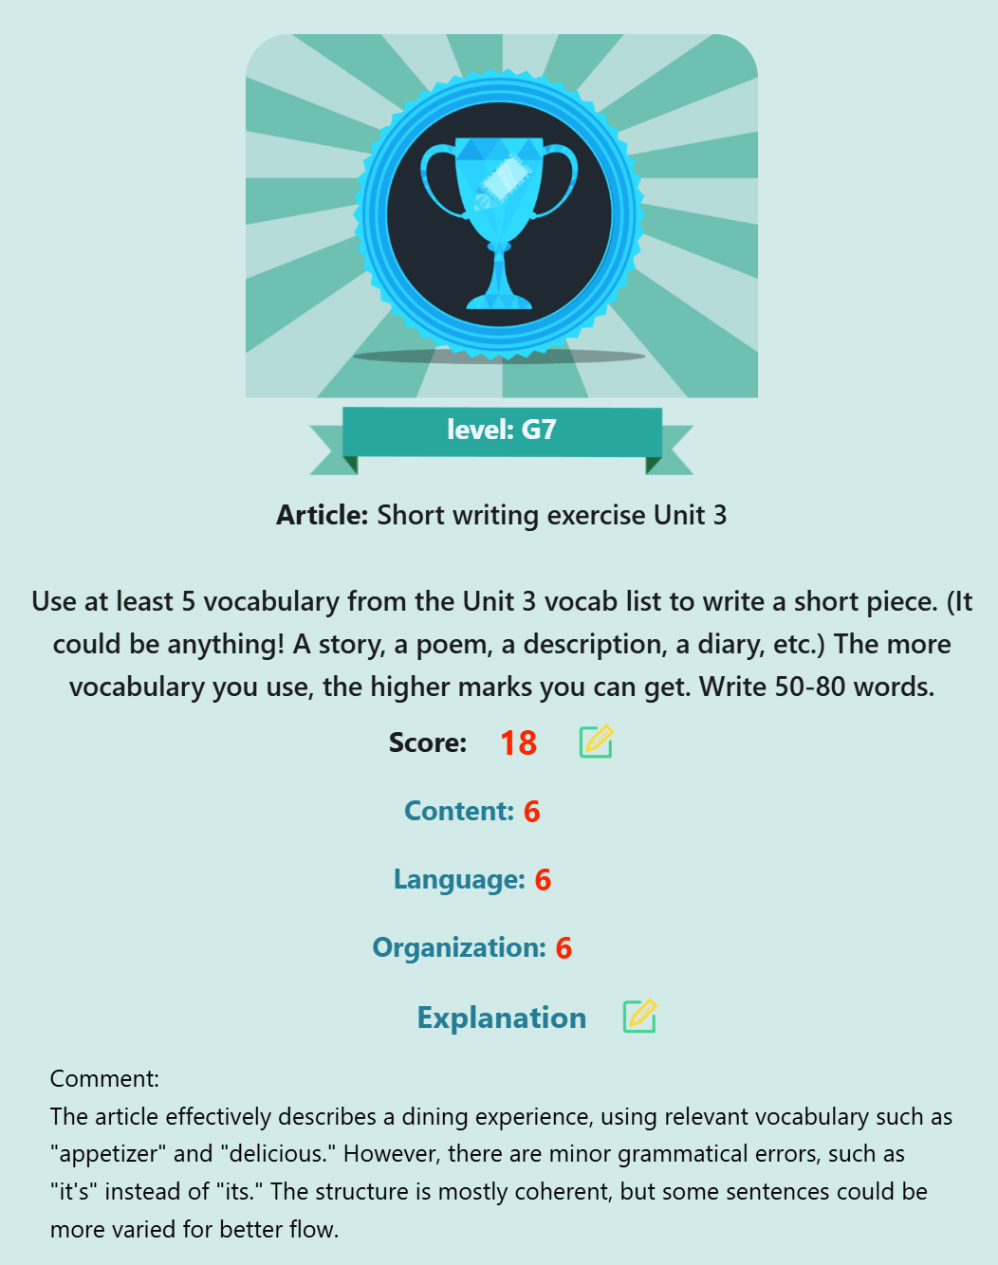
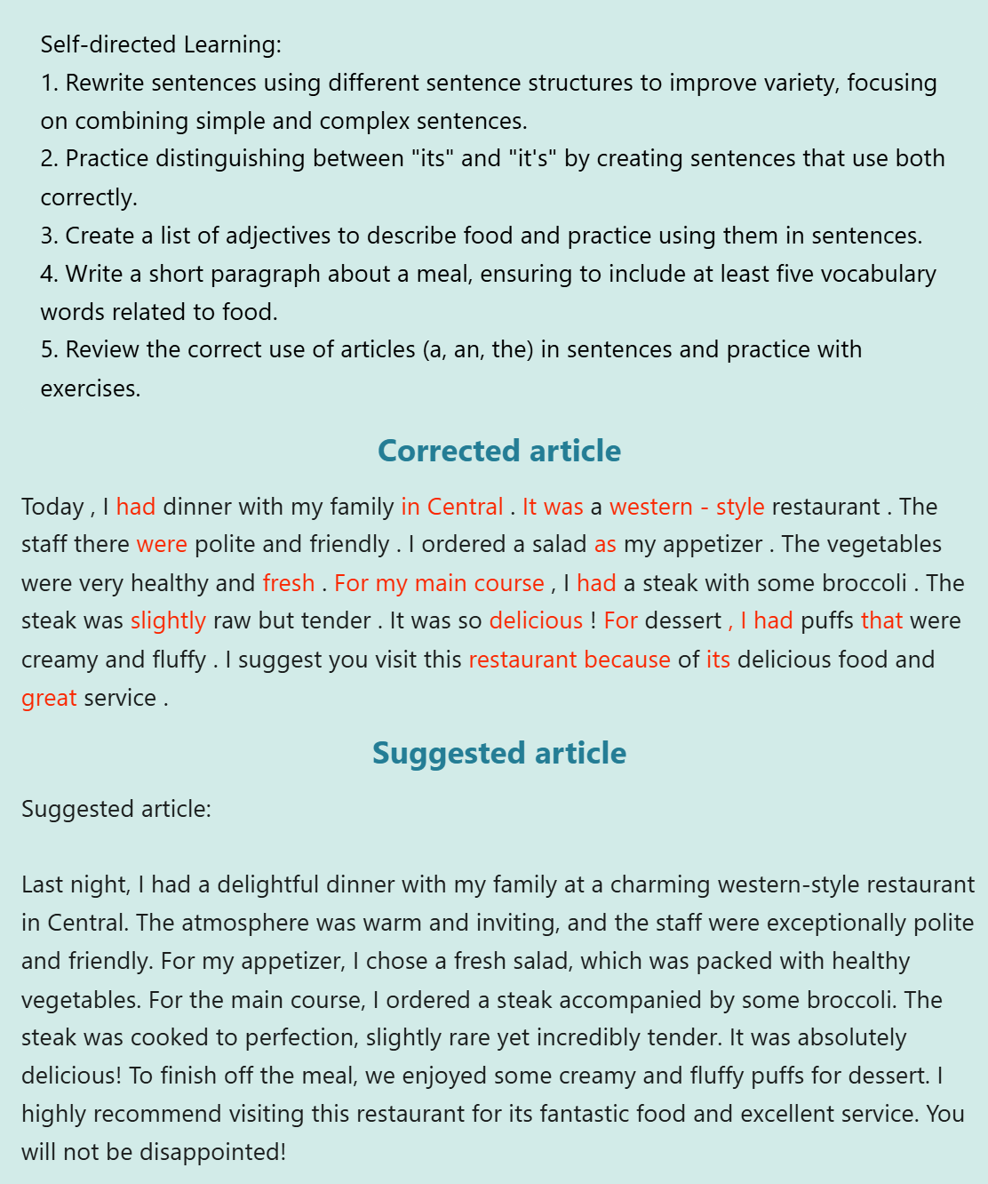

Slide 26
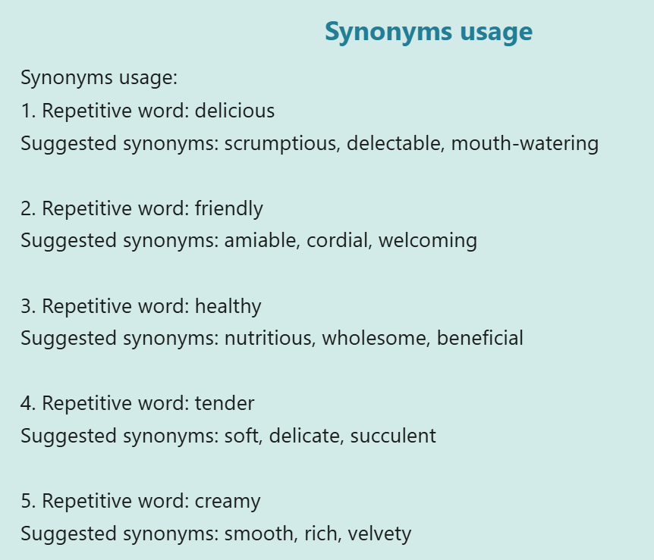
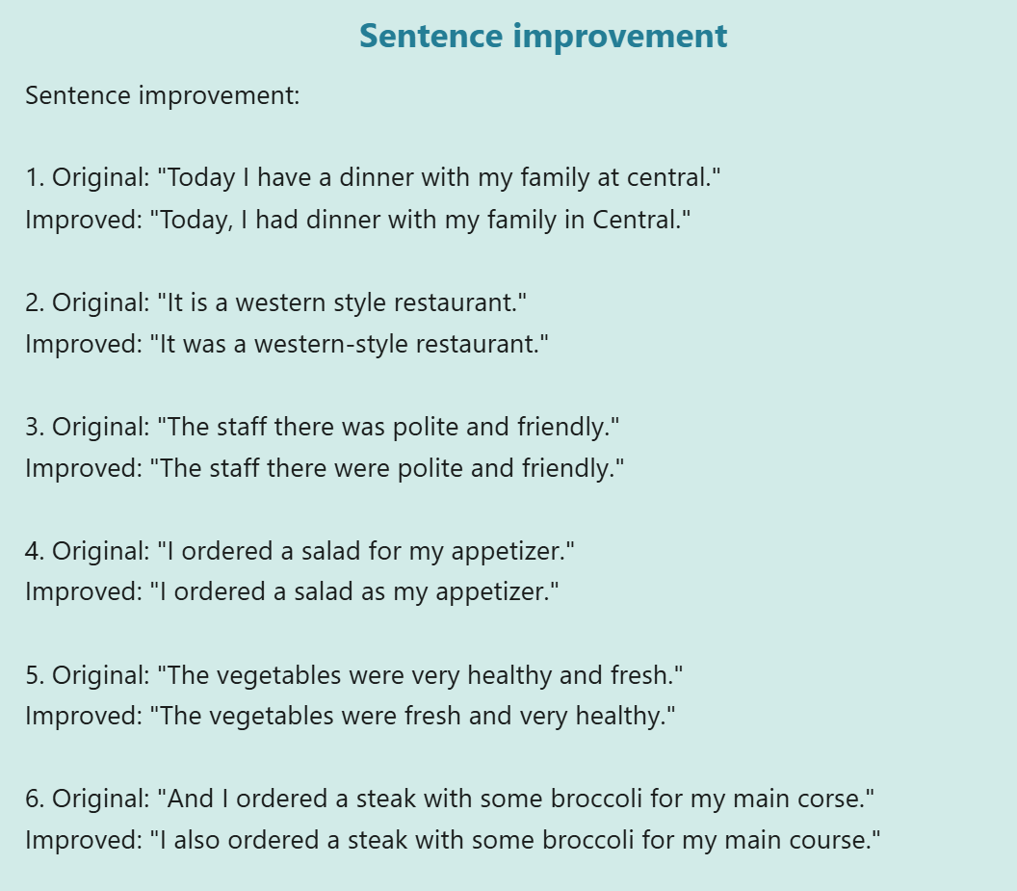

Slide 27
Implementation Strategy
4
Enhancing students' writing skills with the aid of an AI system. (After school)
Then, students should read the comments and reference articles provided by the AI system and write three sentences that improve their articles in their English notebooks.

Slide 28
Implementation Strategy
5
Failed
Enhancing students' writing skills and self-directed learning capabilities through an AI system. (After school)
Students can write articles on a wide range of interesting topics and upload them to the AI system.
Write down the system's feedback in their notebooks.
Collect the students' articles monthly and select the student who has written the most articles to present them with a small gift.

Slide 29
Implementation Strategy
6
Improving students' English speaking skills through the AI system (After school)
Every week, the teacher will assign an article for students to practice reading aloud at home.
Students can practice at home using the AI system, which will identify pronunciation issues.

Slide 30
Implementation Strategy
6
Improving students' English speaking skills through the AI system (English Lesson)
For every lesson, the teacher will select a student in class to read aloud.

Slide 31
Implementation Strategy
- Evaluation
English mark sheet
Students' English results have improved on different papers.

Slide 32
Implementation Strategy
- Evaluation
Student survey on English self-efficacy
• Cultivate students‘ habit of using AI technology for self-directed learning
• Students’ self-efficacy in English has improved

Slide 33
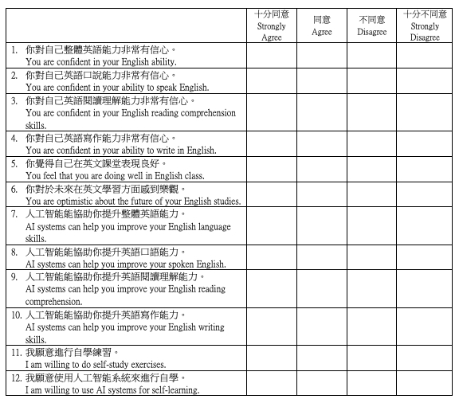

Slide 34
Implementation Strategy
- Evaluation
Teacher workload and work pressure questionnaire
Reduce teachers' work pressure and workload

Slide 35
Data Analysis

Slide 36
Data Analysis - Limitation
Insufficient number of exercises (Total: 9 writing, 11 reading exercises), original plan for each class: 4 writing, 10 reading exercises
Some students do not do their homework on time
S1C, E English Teachers are not the same, although both are highly effective teachers
Research results only work on the Ho Yu elite classes

Slide 37
Data Analysis - Questionnaire
S1 students generally agree that AI can help you improve your English reading comprehension ability, but S1E has a higher level of agreement than other classes.
Compared with the second questionnaire, S1E's level of agreement has increased, while the level of agreement of other classes has decreased.

Slide 38
Data Analysis - Questionnaire
S1 students in all classes agree that AI can help you improve your English writing skills, but S1E has a higher level of agreement than the other classes
Compared to the second questionnaire, S1E's level of agreement has continued to increase, while the level of agreement of other classes has decreased.

Slide 39
Data Analysis - Questionnaire
S1 students in all classes agree that AI can help you improve your oral English, but S1E has a higher level of agreement than other classes
Compared with the second questionnaire, S1E's level of agreement has increased, while the level of agreement of other classes has decreased

Slide 40
Data Analysis - Questionnaire
Except for S1D and E, all other classes had no confidence in their overall English language abilities
S1E showed an upward trend

Slide 41
Data Analysis – Questionnaire Conclusion
A discrepancy was found between the results of S1C and S1E in the research project.
While S1E's data showed that the research project was effective, S1C's data indicated that the research project was ineffective, and in fact, it performed worse than the other classes that did not implement the plan.

Slide 42
Data Analysis – Questionnaire Conclusion
The number of times the exercise was implemented.
S1C only implemented the program 7 times out of the original 14 times throughout the year, while S1E was nearly able to implement the program as planned, 13 times out of the original 14 times.

Slide 43
Data Analysis – Teachers feedbacks
試行AI提升英文具備巨大潛力。AI能提供即時語法反饋和實用建議，如句子改進與同義詞使用，幫助學生掌握語言技巧。此外，AI可協助教師設計包含不同題型的主題閱讀練習，嵌入目標詞彙，節省出題與批改時間。然而，挑戰亦存在。AI難以針對個別學習風格提供個人化反饋，其評估多依賴單一練習的表現，暫時未能整合同一學生的所有輸出數據，進行持續性進展評估，從而限制其應用範圍。此外，AI的評論未必適用於各學習能力學生，學生或難理解評論意圖，與教師按能力量身定制的指導相比有差距。
新功能引入需時間培訓教師與學生，同時因時間壓力及需審查AI質素，增加負擔。總體而言，AI在英文教學有廣闊發展空間，但需平衡技術限制與實際需求，方能真正提升學習效果。(Ms Yeung Tsing Huen)

Slide 44
Data Analysis – Teachers feedbacks
這次試行用AI提升學生英語能力，帶來了顯著的好處。首先，AI能提供個人化學習體驗，老師或學生自己可根據程度調整難度，幫助學生練習聽說讀寫。例如，AI可以即時糾正語法錯誤，或生成全面的作業報告，讓學生快速地了解錯誤和改正。部分更附帶不同模式選擇，讓學生按自己能力挑選批改模式。此從老師的立場來看，AI的靈活性能讓教師融合不同學習元素，如特定詞彙、主題和文體，製作校本化的練習。此外，AI的數據分析功能可幫助老師了解學生的學習進度與弱點，設計更有效的教學策略。這些好處都能有效改善和奠定學生的語文基礎。(To be con’t )

Slide 45
Data Analysis – Teachers feedbacks
然而，在處理學生思維上，AI內容的準確性和適應性可能不足，尤其是針對文化差異或語言細微之處，可能導致錯誤學習或誤解。例如老師在批改作文上，評分上有很多人性化的考量，而且不同公開考試亦有不同評分準則，這些與AI的劃一性評分有很大出入。AI的寫作作業報告中，在「內容」及「組織」方面給予的回饋大多比較籠統，未能有效指出文章內不合理或思路不通之處，也未能針對學生思路提供有效的建議。因此，老師需適時介入，補足這方面的缺憾。 (Ms Lui Wing Sze)

Slide 46
Data Analysis – Result in UT & Exam
The number of students whose standard Score increased
 | Control Classes | Experiment Classes
Paper 1 | 22 | 32
Paper 3 | 24 | 24
Paper 4 | 25 | 30

Slide 47
Data Analysis – Result in UT & Exam
Paper 1 & 4: Experiment Classes have MORE students whose standard score increased
Paper 3: Same number of students whose standard score increased

Slide 48
Data Analysis – Result in UT & Exam
The number of students whose standard Score increased
 | S1C | S1E
Paper 1 | 19 | 13
Paper 3 | 16 | 8
Paper 4 | 16 | 14

Slide 49
Data Analysis – Result in UT & Exam
All Papers: S1C have more improvement than S1E

Slide 50
Data Analysis – Result in UT & Exam Conclusion
AI CAN improve a student's exam mark under the condition of sufficient exercises.
Self-efficacy is NOT related to the exam mark in this research.

Slide 51
Reflection

Slide 52
Reflection
Teaching methodology MUST be changed

Slide 53
Reflection
Vocabulary is still the MOST important

Slide 54
Reflection
Communication is relatively MORE important than grammar

Slide 55
Reflection
Students learn to
EVALUATE
rather than write

Slide 56
Next Step

Slide 57
Next Step
Implement in the foundation classes
More AI exercises
More schools to join
Implement a NEW teaching methodology research projects

Slide 58
“NEW” teaching methodology with AI research project
Theme: What do we eat?
Pre-Lesson
  Students find out the different types of meals and choose one of them
  Students find the useful vocabulary of the meal that they chose through AI (Need to submit the prompt)
Lesson
  Students introduce what they choose and why they choose

Slide 59
“NEW” teaching methodology with AI research project
Theme: What do we eat?
Pre-Lesson
  Students complete Reading Comprehenion about the theme
  Students complete the spelling exercise with the vocabuary
  Prepare the read aloud （textbook passage）
Lesson
  Normal lesson

Slide 60
“NEW” teaching methodology with AI research project
Theme: What do we eat?
Pre-Lesson
  Students prepare the hint of the composition by using AI (Need to submit the prompt)
Lesson
  Students complete the composition
Post-Lesson
  Students mark their neighbor passage by using AI

Slide 61
One more thing……

Slide 62

Contact
Email: lkr@hoyu.edu.hk

