Slide 1




Process Writing Enhancement Powered by AI
Making use of Artificial Intelligence to Provide Feedback and Polish Students’ Writing
Dr. Law Man Hei & Ms Law Man Tung

Slide 2
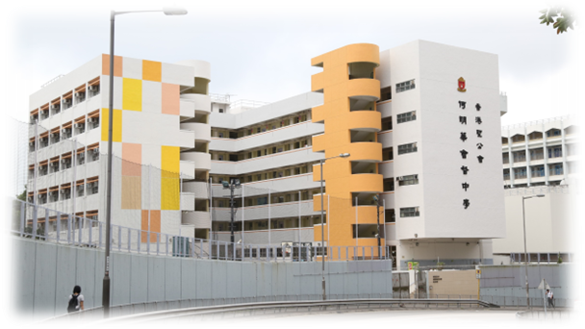
HKSKH BISHOP HALL SECONDARY SCHOOL
Located in Sau Mau Ping (Kwun Tong)
IT in Education Centre of Excellence, EDB(since 2019/20)
Microsoft Showcase School (since 2017)
Microsoft teams and OneNote are widely used
Fully adopted BYOD (iPad Apple Pencil) in 2020/21
Our E-learning Resource Hub
https://hkedcity.instructure.com/courses/4760

Slide 3

BACKGROUND
Many students struggle with generating new ideas, elaborating and producing a coherent text
Some of them may even choose to send the writing prompts to AI and hope to get the writing immediately done by it
⟶ What is the appropriate use of AI?

Slide 4

SITUATION
Write a letter to the editor expressing your views on IShowSpeed’s visit to Hong Kong and the impacts to the tourism industry.
PROCEDURES
STUDENT
TEACHER
01
Compose their writing
02
Send writing to AI bot
AI BOT
03
Give response and feedback accordingly
What are the results and impacts to students?

Slide 5
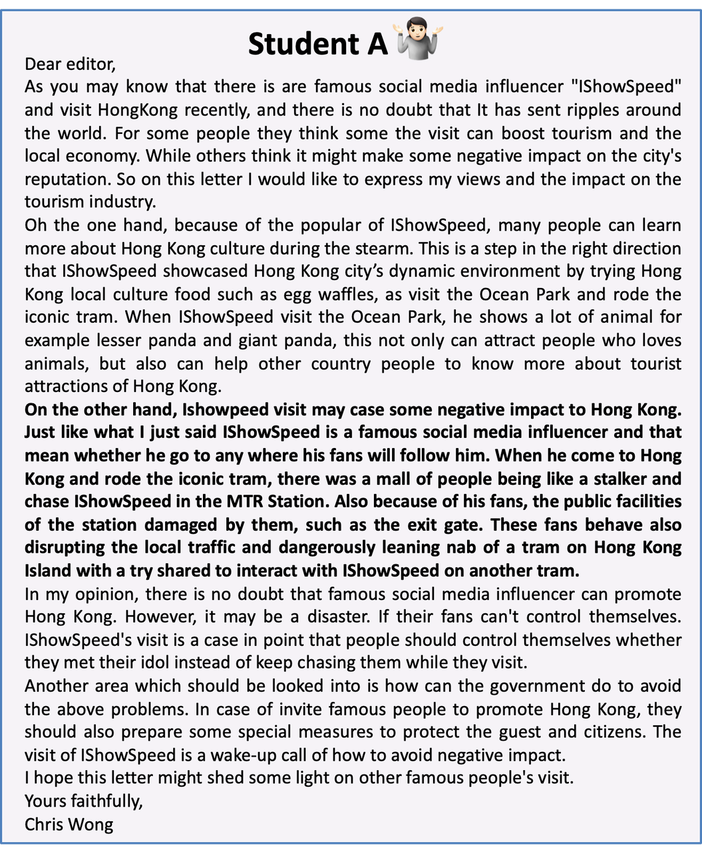
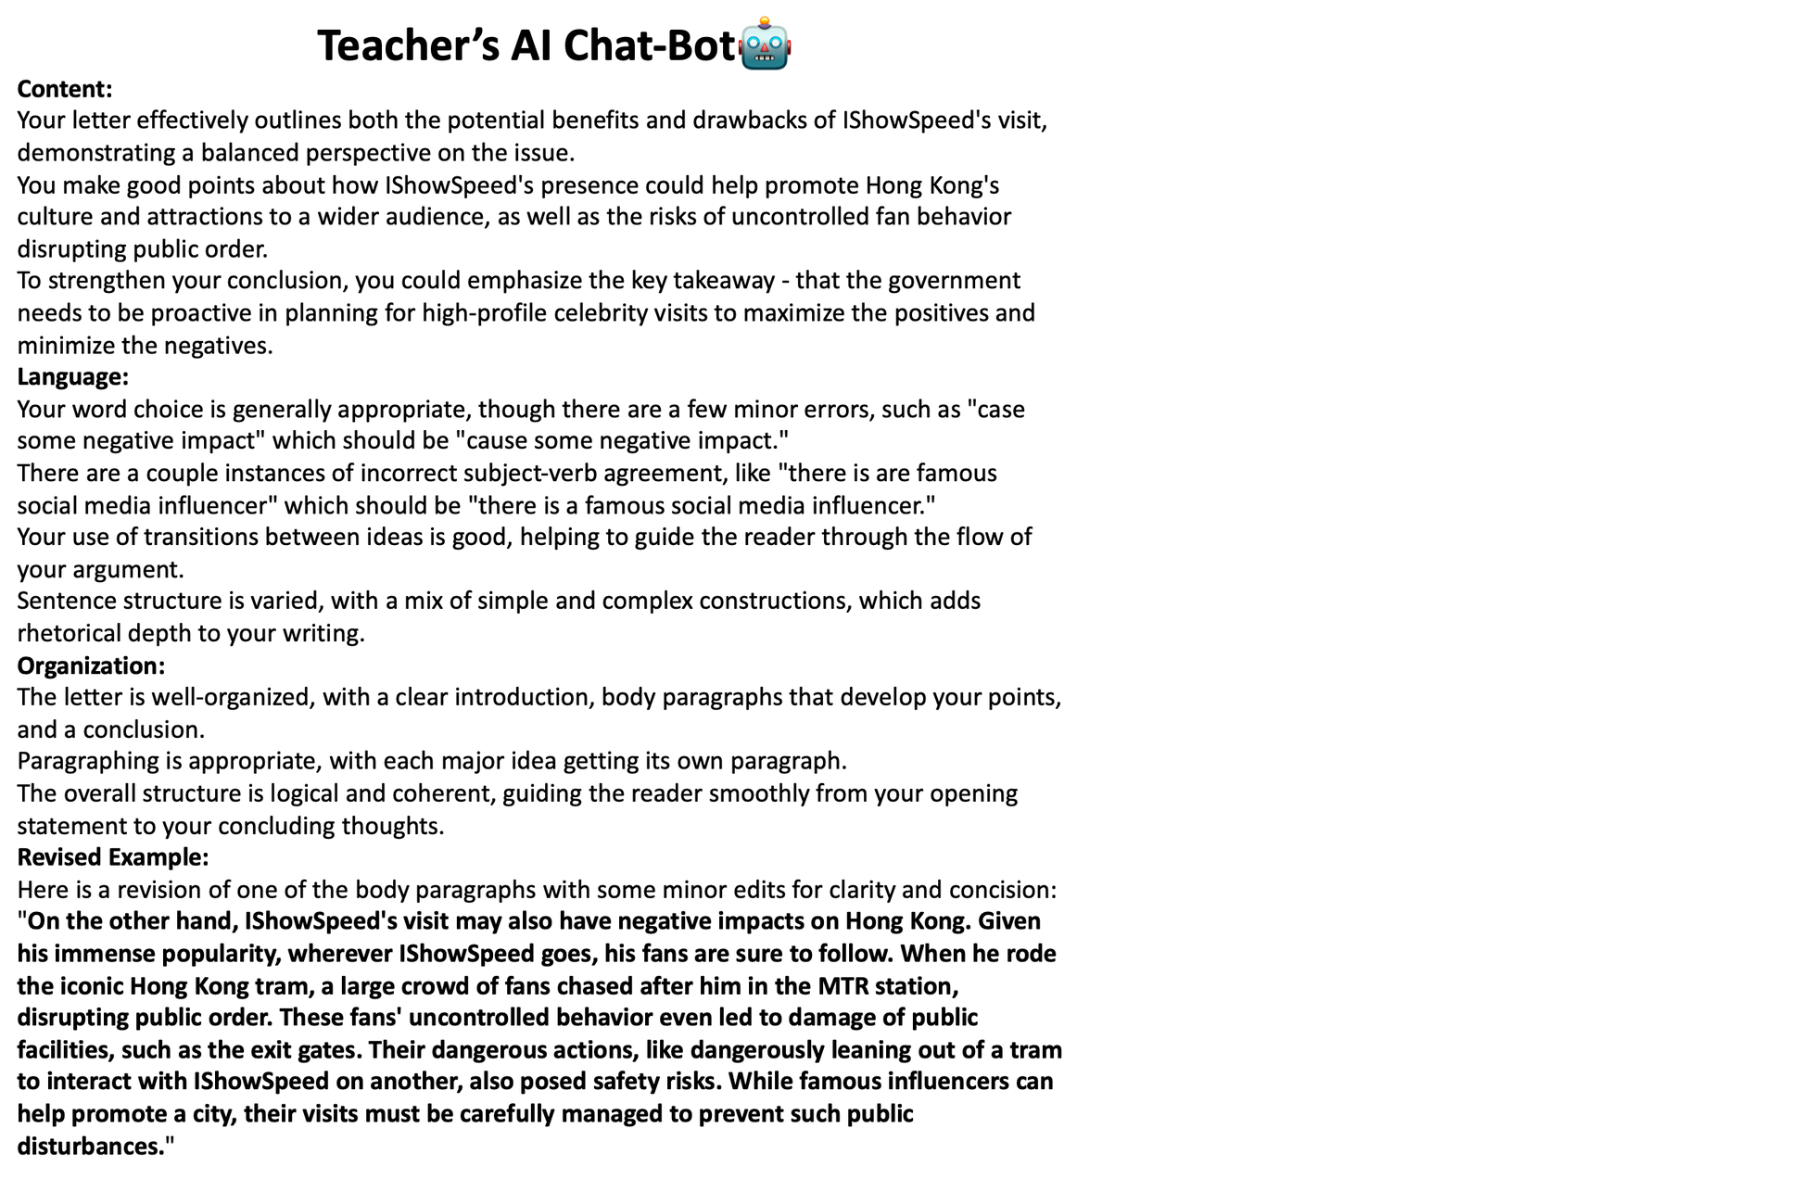



Slide 6
Preposition
On the other hand, Ishowpeed visit may case some negative impact to Hong Kong. Just like what I just said IShowSpeed is a famous social media influencer and that mean whether he go to any where his fans will follow him. When he come to Hong Kong and rode the iconic tram, there was a mall of people being like a stalker and chase IShowSpeed in the MTR Station. Also because of his fans, the public facilities of the station damaged by them, such as the exit gate. These fans behave also disrupting the local traffic and dangerously leaning and of a tram on Hong Kong Island with a try shared to interact with IShowSpeed on another tram.
🤷🏻
Verb tense inconsistency
Student A
Unconcise word choice
Revised Example:
On the other hand, IShowSpeed's visit may also have negative impacts on Hong Kong. Given his immense popularity, wherever IShowSpeed goes, his fans are sure to follow. When he rode the iconic Hong Kong tram, a large crowd of fans chased after him in the MTR station, disrupting public order. These fans' uncontrolled behavior even led to damage of public facilities, such as the exit gates. Their dangerous actions, like dangerously leaning out of a tram to interact with IShowSpeed on another, also posed safety risks. While famous influencers can help promote a city, their visits must be carefully managed to prevent such public disturbances.
Teacher’s AI Bot
🤖

Slide 7
Preposition
On the other hand, Ishowpeed visit may case some negative impact to Hong Kong. Just like what I just said IShowSpeed is a famous social media influencer and that mean whether he go to any where his fans will follow him. When he come to Hong Kong and rode the iconic tram, there was a mall of people being like a stalker and chase IShowSpeed in the MTR Station. Also because of his fans, the public facilities of the station damaged by them, such as the exit gate. These fans behave also disrupting the local traffic and dangerously leaning and of a tram on Hong Kong Island with a try shared to interact with IShowSpeed on another tram.
🤷🏻
Verb tense inconsistency
Student A
Unconcise word choice
Exercise:
Preposition Usage:
Fill in the blanks with the appropriate preposition:
a) IShowSpeed's visit has caused disruption _______ the MTR stations.
b) The government should focus _______ promoting Hong Kong's cultural attractions.
c) Damage _______ public property is unacceptable during these high-profile visits.
Teacher’s AI Bot
🤖
Verb Tense Consistency:
"IShowSpeed visit the Ocean Park, he shows a lot of animal"
Rewrite the following sentence to maintain consistent verb tense:
IShowSpeed visits the Ocean Park and shows the animals to his followers.

Slide 8
👩🏻‍🏫
Can you provide one more paragraph of revised example and additional grammar exercises for the student to work on?
Teacher’s Request
Revised Example Paragraph:
Another area of concern regarding IShowSpeed's visit is the potential damage to Hong Kong's reputation. While the influencer's large following can certainly draw attention to the city, the type of attention he attracts may not be the most desirable. IShowSpeed is known for his outrageous and often inappropriate behavior, which he frequently displays for the entertainment of his young fan base. Allowing such a personality to serve as an ambassador for Hong Kong risks reducing the city's rich cultural heritage to merely a backdrop for viral antics. Tourism campaigns should aim to highlight the depth and sophistication of Hong Kong, not just momentary sensationalism. The government must carefully consider the long-term reputational implications before endorsing the visits of controversial influencers like IShowSpeed.
Teacher’s AI Bot
🤖
Subject-verb agreement:
"there is are famous social media influencer"
Correct the subject-verb agreement in the following sentences:
There _______ (is/are) several factors to consider regarding IShowSpeed's visit.
The group of fans _______ (disrupt/disrupts) the public order at the station.
Parallel Structure:
Rewrite the following sentence to maintain parallel structure:
The tourism board should focus on attracting high-quality visitors, ensuring public safety, and to highlight Hong Kong's cultural heritage.
Comma Usage:
Add commas where necessary in the following sentence:
While influencers can boost tourism their impact should not come at the cost of social order and public safety.

Slide 9



PROMPT ENGINEERING
How to provide instructions to guide your AI to produce specific outputs, specifically helping your students?
Pick your AI model
Set your basic criteria (how should your bot perform):
Identity: __(Subject)___ Teacher
Types of feedback: ________
Personalised exercises
3. Adding additional information:
DSE Marking Scheme
Students’ Abilities
Tone: encouraging
4. Add in new request if needed

Slide 10
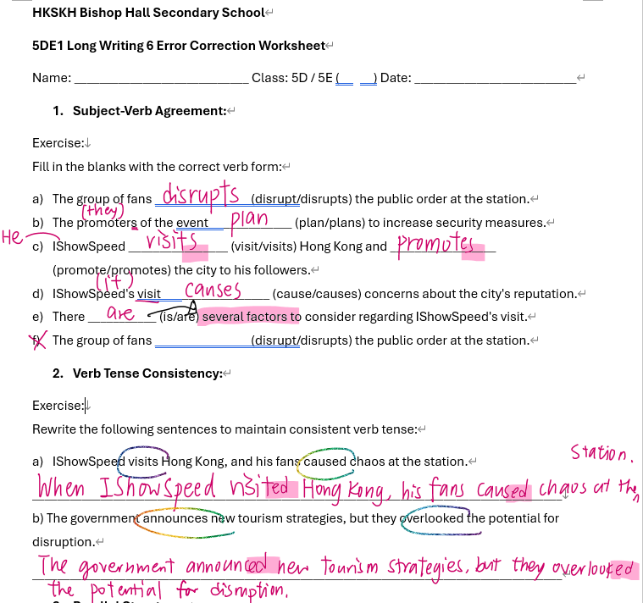
RESULT
Lesson Material
AI helps teachers with the design of lesson materials
e.g. post-writing error correction worksheet

Slide 11
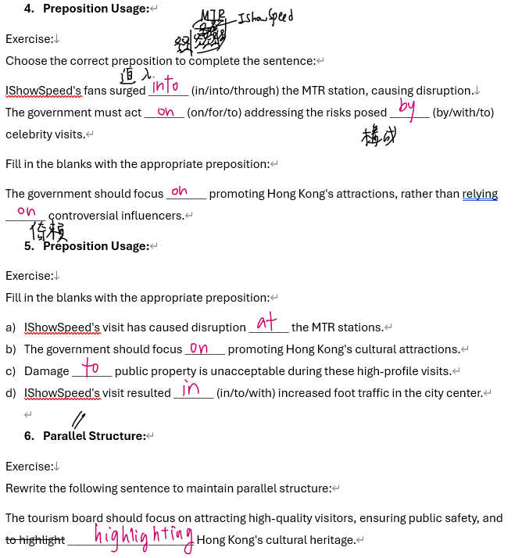
RESULT
Lesson Material
Focus on the common mistakes made by the class

Slide 12
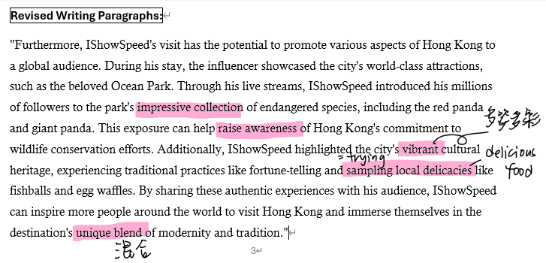
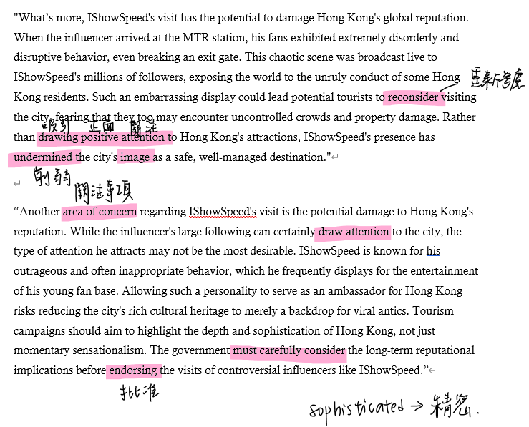

Each student receives a revised writing paragraph
⟶ Manageable to students
⟶ They can learn the vocabulary items and expressions correspondingly.

Slide 13

CHANGE IN LEARNING AND TEACHING
Traditionally, students were asked to correct the whole piece of writing, following teachers’ marking.
Making use of AI, the bot helps both teachers and students to identify and categorize specific grammatical mistakes
AI bot revises a part of students’ writing for them to focus on
More manageable to students to understand and improve

Slide 14
THANK YOU

