Slide 1
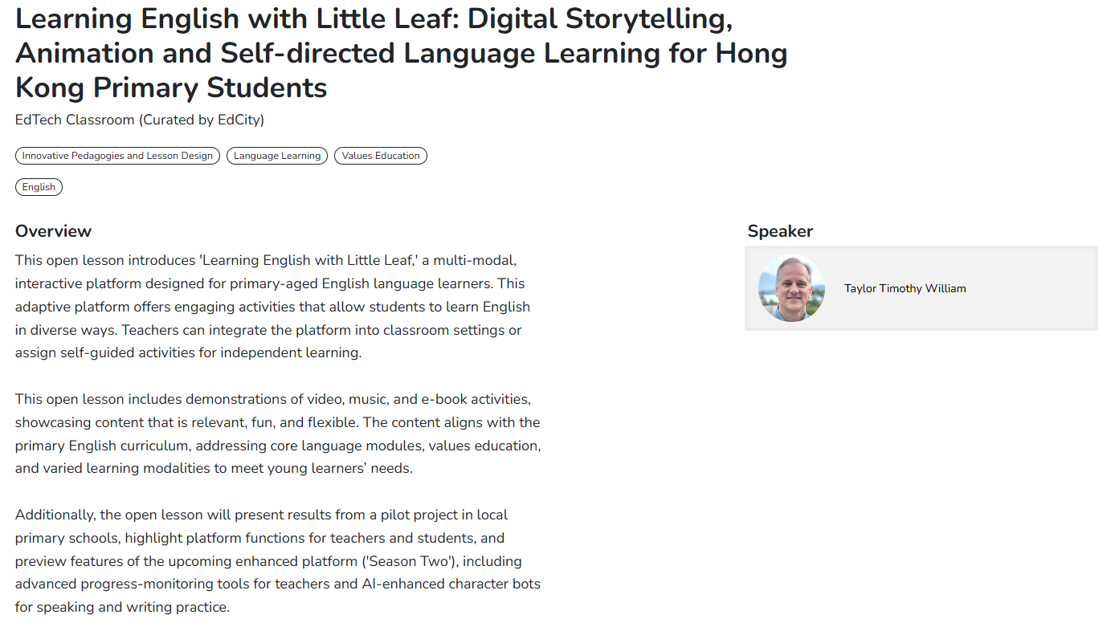

Slide 2

Learning English with Little Leaf
Digital Storytelling, Animation, and Self-Directed Language Learning
for Hong Kong Primary Students
https://www.littleleaf.hk
Dr. Timothy Taylor, Associate Head of Department
Department of English Language Education,
The Education University of Hong Kong
2nd July 2025
3:00 p.m.

Slide 3
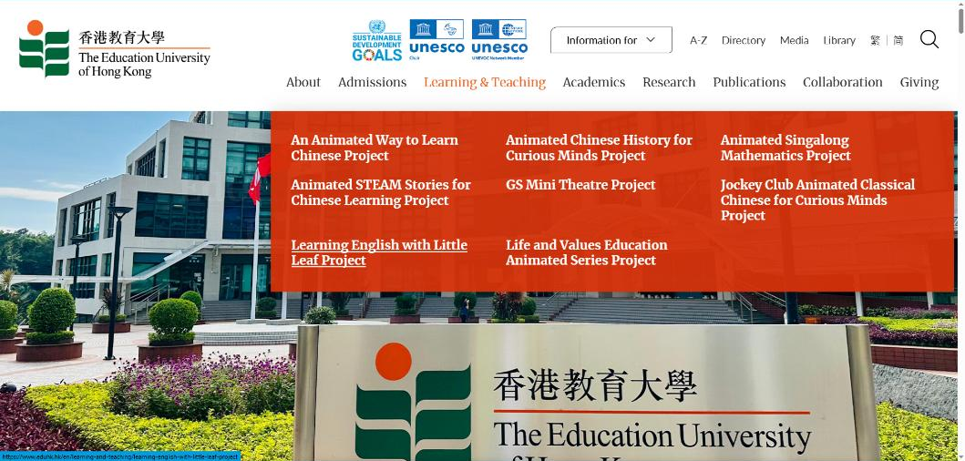

Little Leaf Project Background
During the COVID pandemic, EdUHK President Stephen Cheung initiated a large-scale effort to provide video content for several subjects tailored to local primary students. The Department of ELE developed a package of innovative learning content, incorporating many principles of effective language learning in the Hong Kong context. This is “Learning English with Little Leaf”.

Slide 4

The Learning English with Little Leaf Platform: https://www.littleleaf.hk

Slide 5
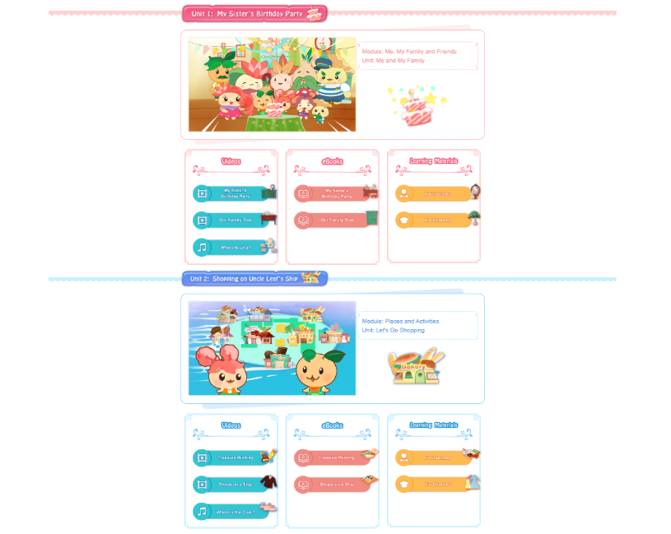
The Learning English with Little Leaf Platform: https://www.littleleaf.hk

Slide 6

The Learning English with Little Leaf Platform: https://www.littleleaf.hk

Slide 7
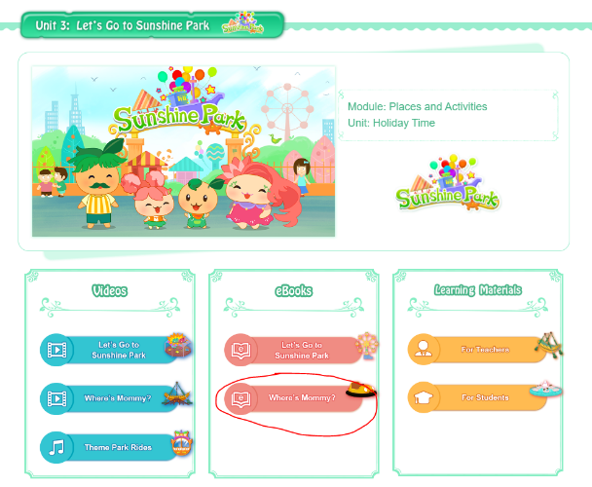
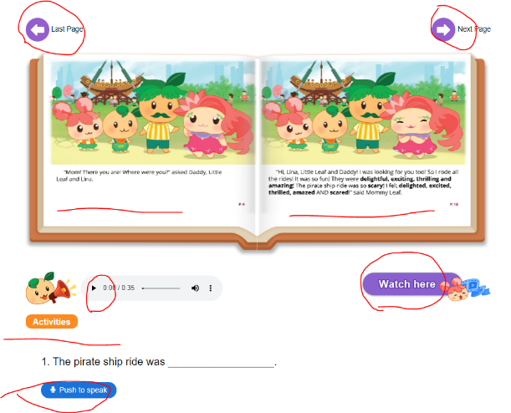
e-Books offer multimedia access to stories and new vocabulary with many online activities, including story and music videos, ebooks, and speaking and writing practice.
https://www.littleleaf.hk

Slide 8
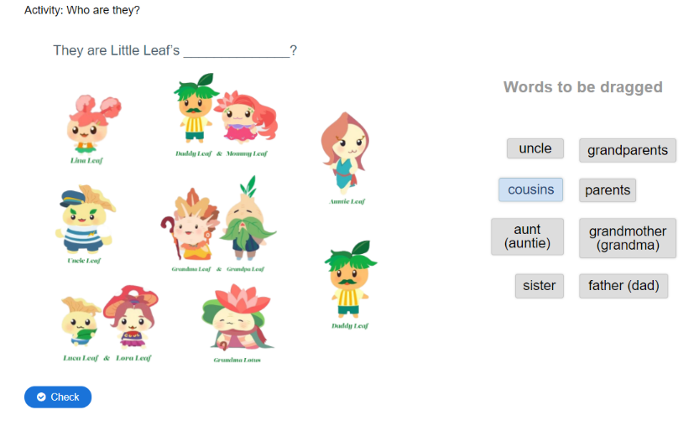
Example Sharing- Digital Activities
Speak the Words
Drag the words activities
Multiple Choice
Single Choice Set
Image Sequencing
Drag and drop
Fill in the blanks
Image Pairing
Dictation
Find the Hotspot/ Multiple Hotspots

Slide 9
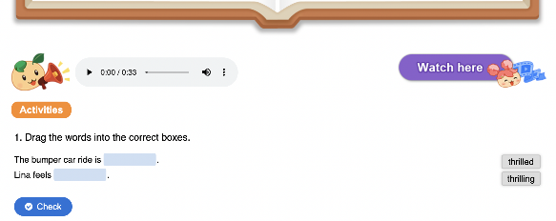
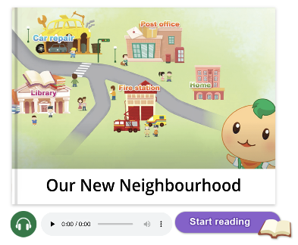
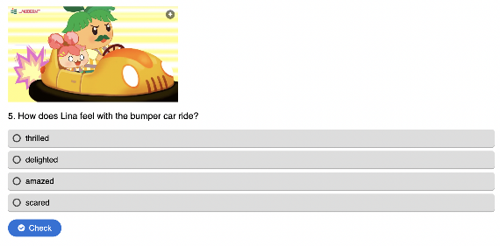
Teaching Little Leaf Scenario 1:
Self-directed language learning
Introduce the platform to students and let them use it in free time

Slide 10
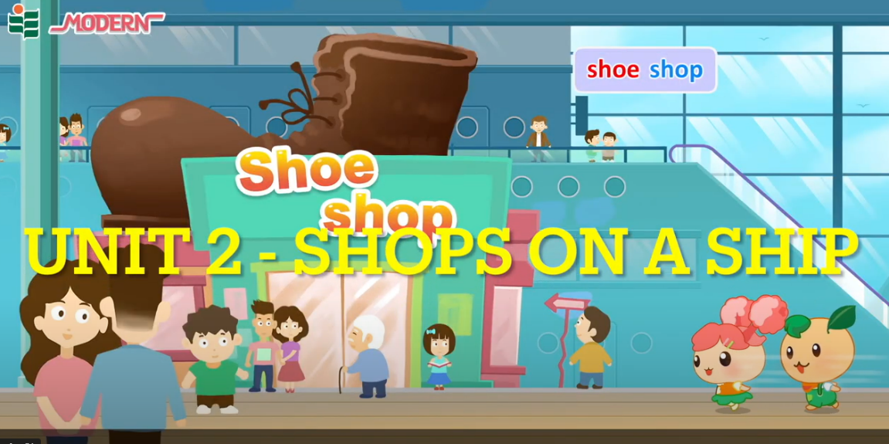
Unit 2 - Shops on a Ship
https://youtu.be/rFJFNQmt4pM

Slide 11
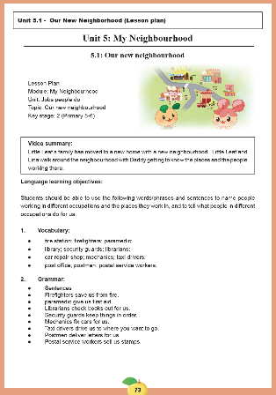
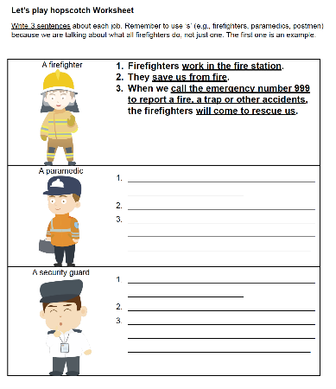
Teaching Little Leaf Scenario 2: Integrating Little Leaf in the school-based curriculum
Match the learning objectives (vocabulary/ grammar/ sentence structures)
Use the Little Leaf materials in daily teaching (e.g. eBooks, videos, songs and worksheet)
Assign eBooks as homework (teachers can check students’ performance via the reporting system)

Slide 12
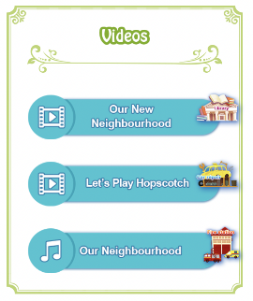
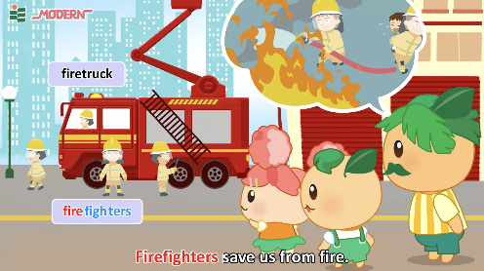
Teaching Little Leaf Scenario 3: Using Little Leaf as supplementary learning materials
Students can sing the songs at the beginning of the lesson to arouse students’ interest
Students can learn the vocabulary and sentence patterns in a subconscious way through the repetition of target language

Slide 13

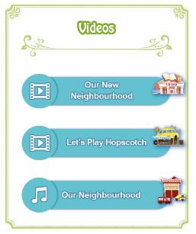
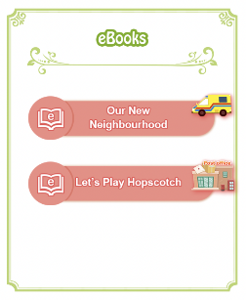
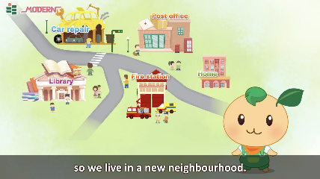
Using as supplementary learning materials (cont.)
Teachers can assign the videos as pre-learning or extended learning materials
Students can watch the videos at home to get a basic understanding of the topic or to consolidate their language learning

Slide 14
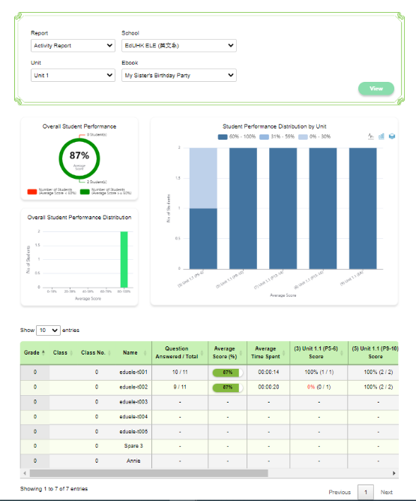
Online resource for teachers:
Teacher Reports
Class/Student participation
Time spent
Questions answered
Score

Slide 15
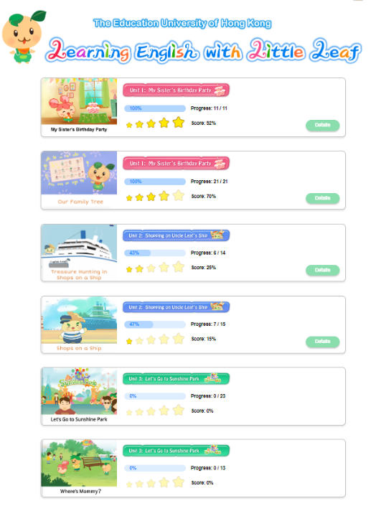
Online resource for students and parents:
Student Reports
Participation
Progress
Overall Performance

Slide 16
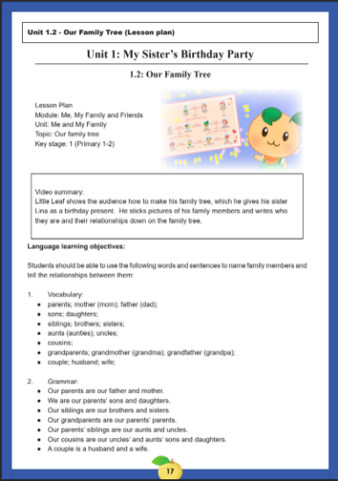
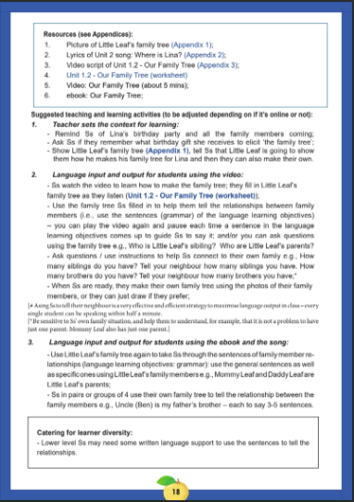
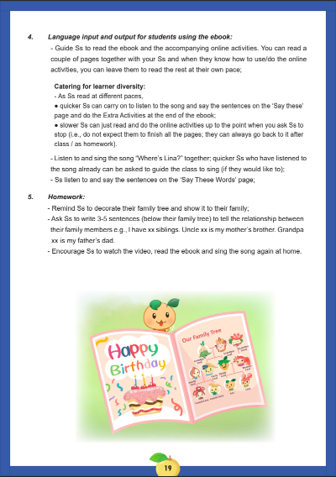
Teaching and Learning Materials:
Lesson Plans, Worksheets and Scripts

Slide 17
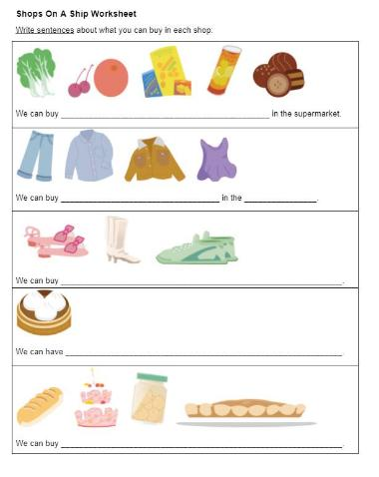
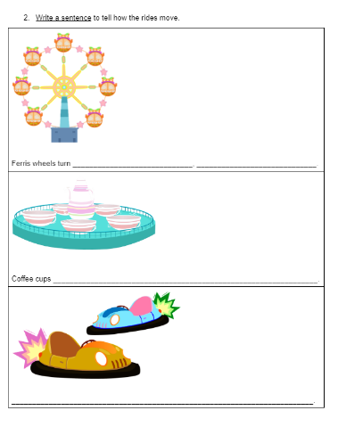
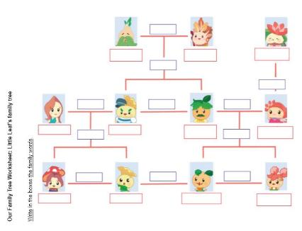
Teaching and Learning Materials:
Lesson Plans, Worksheets and Scripts

Slide 18
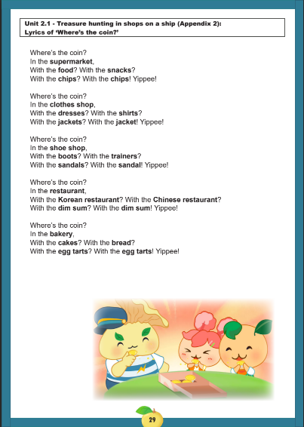
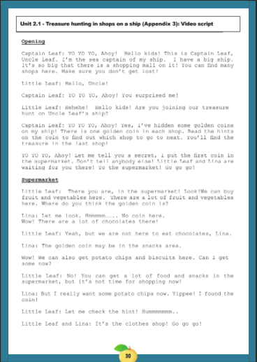
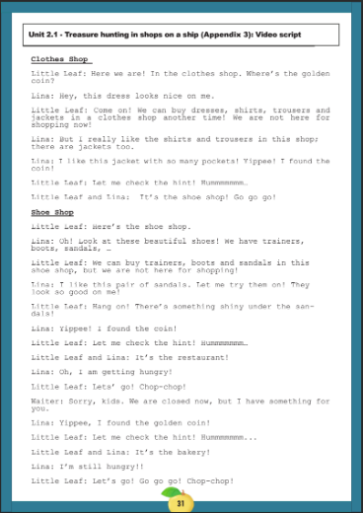
Teaching and Learning Materials:
Lesson Plans, Worksheets and Scripts
Song Script: “Where’s the Coin?”
Story Script: “Treasure Hunting in Shops on a Ship”

Slide 19
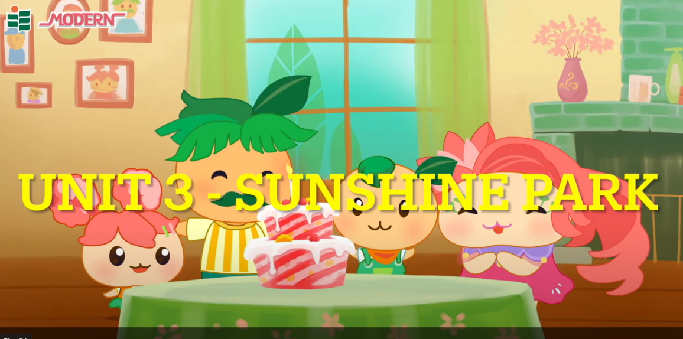
Unit 3 - Sunshine Park
https://youtu.be/M2YaJKRaWyY

Slide 20
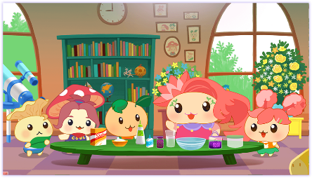
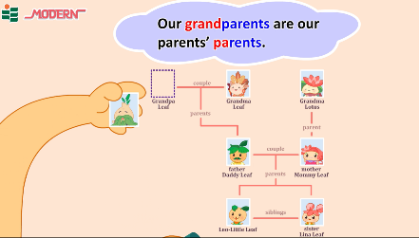
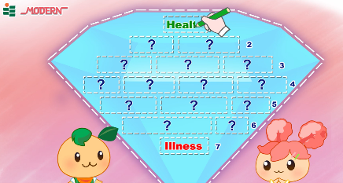
Teaching Little Leaf Scenario 4:
English activities in school or at home
Students participate in a STEM activity
Students make “Safe Slime” together at school
Students make a “Family Tree” with family photos
Students write their own “Diamante Poem”
Students read the eBooks and watch the videos at home

Slide 21
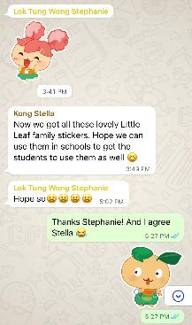
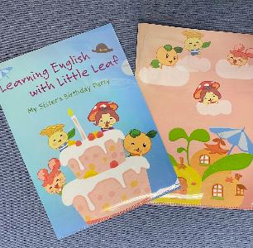
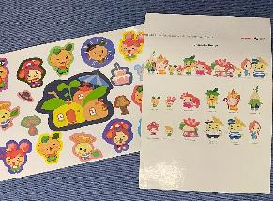
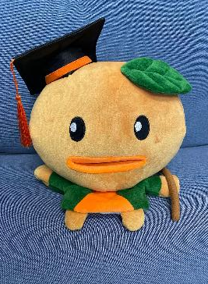
Promotional Items for Tasks and Activities
Files
Stickers
WhatsApp Stickers
Puppets

Slide 22
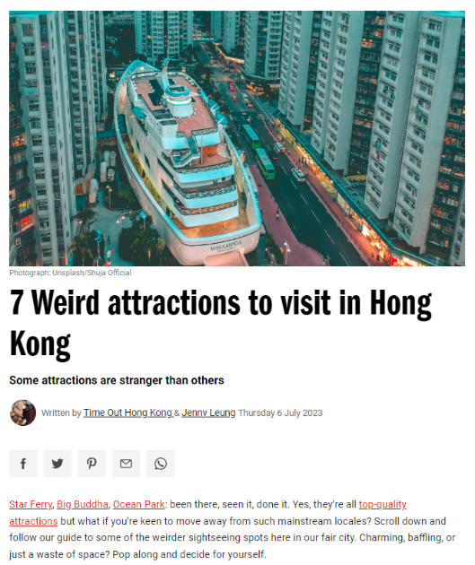
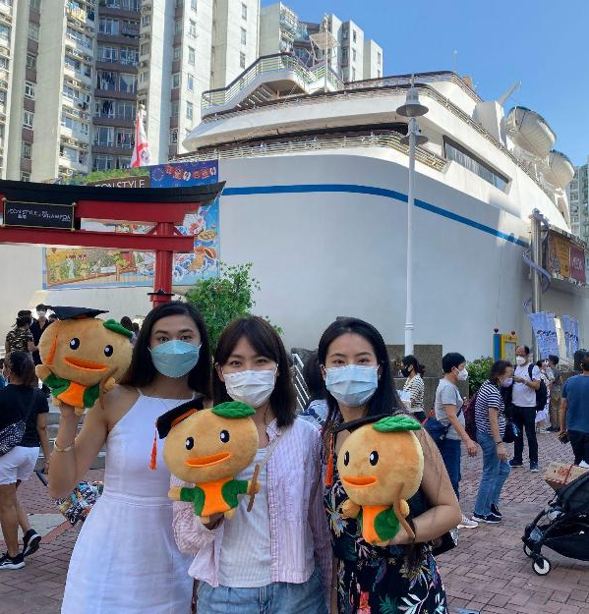
Shopping on a Ship with Little Leaf and Friends

Slide 23
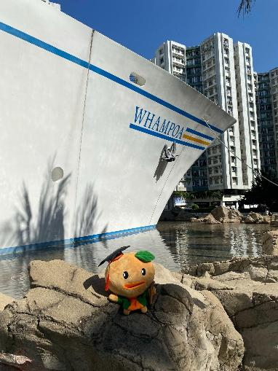
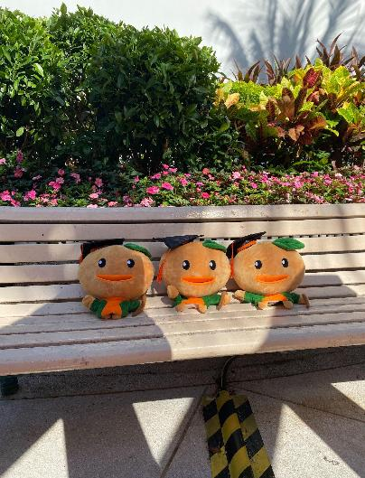
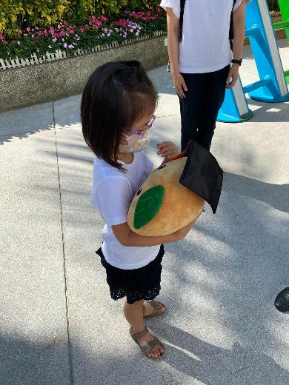
Shopping on a Ship with Little Leaf and a New Friend

Slide 24

Unit 4 - Making Slime
https://youtu.be/B1JDNOrlGsc

Slide 25
The First Season of Little Leaf has 6 Units, 12 Episodes, 12 e-Books, 6 songs
Module and Unit | Story Video/ e-Book 1 | Activity Video/ e-Book 2 | Music Video | Integrated Activity (Text Type) | Language Learning Objectives
1. Me, My Family and Friends: Me and My Family | My Sister’s Birthday Party | Our Family Tree | Where is Lina? | Making a Family Tree (Simple Graph) | ☐ Vocabulary: Family members ☐ Sentence structure: _________is/are_____ and_________.
2. Places & Activities: Let’s Go Shopping | Treasure Hunting on Uncle Leaf’s Ship | Shops on a Ship | Where’s the Coin? | Making a Map of Shops (Brochure) | ☐ Vocabulary: Shops ☐ Sentence structure: We can buy ________ in _________.
3. Places & Activities: Holiday Time | Let’s Go to Sunshine Park | Where’s Mommy? | Theme Park Rides | Looking for Mommy (Directions) | ☐ Vocabulary: theme parks rides; adjectives describing feelings ☐ Verb phrases: describing rides

Slide 26
The First Season of Little Leaf has 6 Units, 12 Episodes, 12 e-Books, 6 songs
Module and Unit | Story Video/ e-Book 1 | Activity Video/ e-Book 2 | Music Video | Integrated Activity (Text Type) | Language Learning Objectives
4. Happy Days: Leisure Activities | Making Slime: Getting things ready | Making Slime | It’s Slime Time! | Making Slime (Giving Instructions) | ☐ Vocabulary: quantifier; ingredients and adjectives. ☐ Grammar: The language of instruction (imperative (do what) + noun phrase (quantity of what is needed) + preposition phrase / until-clause (where / how to do it))
5. My Neighbourhood: Jobs People Do | Our New Neighbourhood | Let’s Play Hopscotch with our Neighbourhood | Our Neighborhood | Playing Hopscotch (Playing a Game) | ☐ Vocabulary: Community facilities ☐ Grammar: Sentences; The when-clause
6. Changes: Now and Then | Life before and during COVID | Writing a Diamante Poem about COVID | We Used To Be | Writing a Diamante (Poem) | ☐ Vocabulary: nouns, adjectives and verb+ing ☐ Grammar: used to + verb

Slide 27
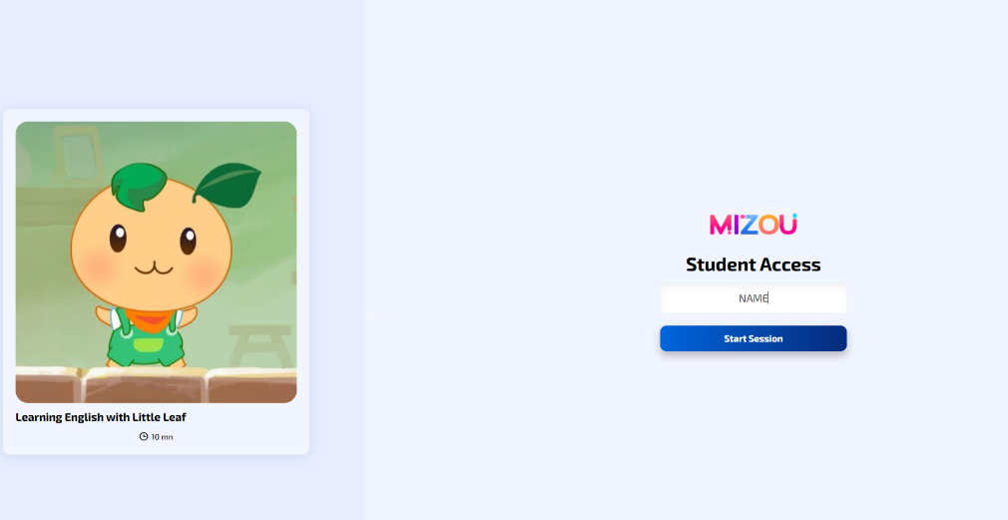

Little Leaf Chatbot
https://mizou.com/login-thread?ID=rFZM3jyCFvp6SpYPPLVBwzZjIomaz4EeBLCBdrGgFZM-84154

Slide 28
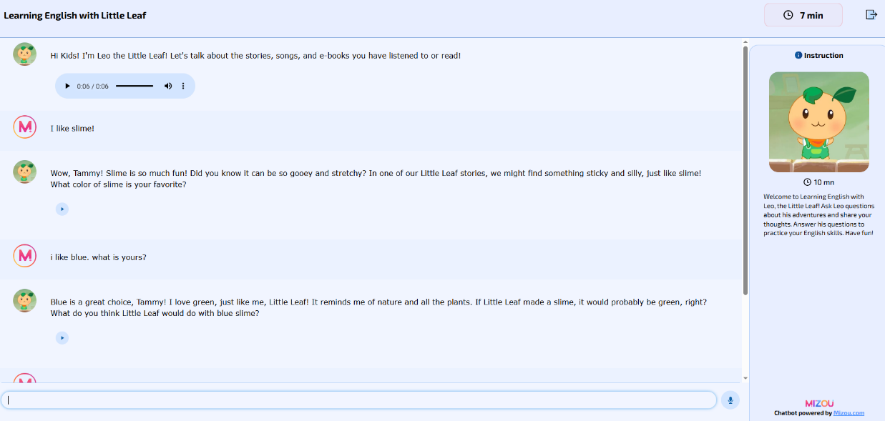
Little Leaf Chatbot - Student Practice

Slide 29
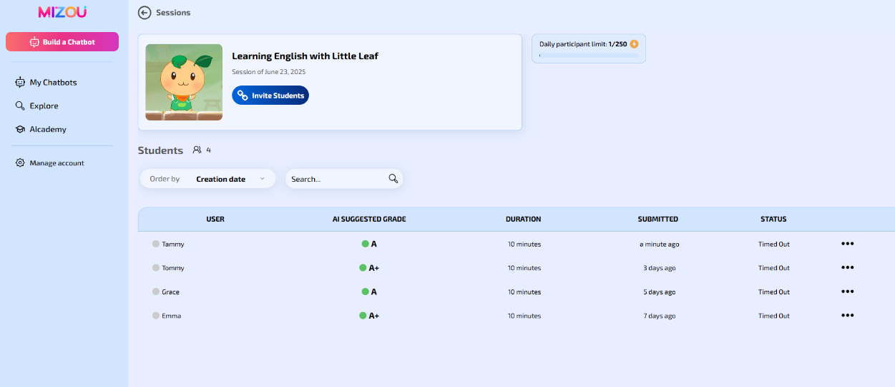
Little Leaf Chatbot - Teacher Monitoring

Slide 30
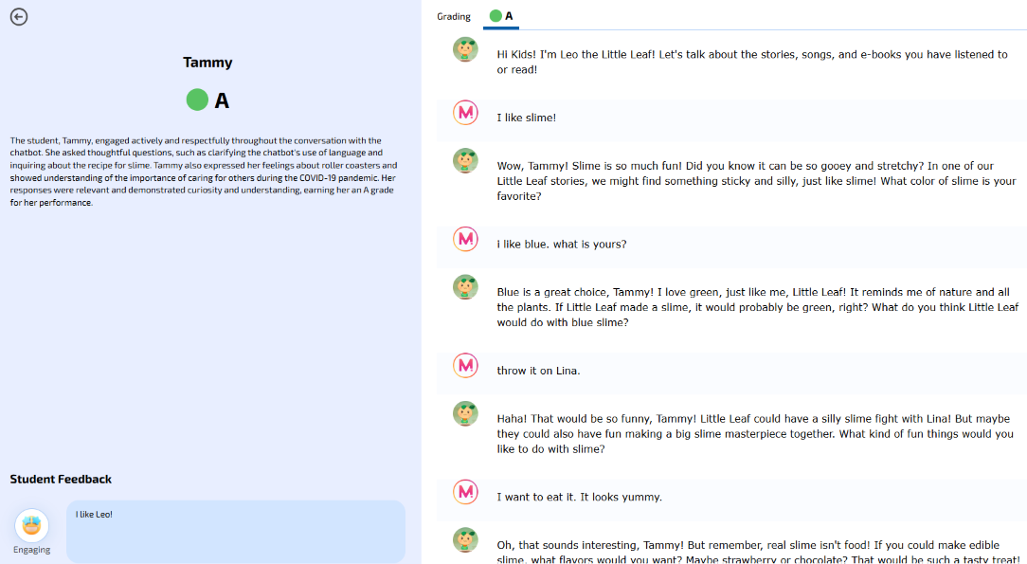
Little Leaf Chatbot - Teacher Monitoring

Slide 31

Pedagogical & Language Learning Principles of Little Leaf
Fun learning experiences (consider affective environment and motivation)
Safe (low anxiety, low stress)
Phonics/Vocabulary/Speaking (Recognising sound patterns, stress, intonation)
Assessment for Learning (Assessment is an opportunity to practice and learn)
Clearly contextualized content (stories, activities and songs with familiar characters)
Task orientation and Integrated skills (“Learning by doing”)
Multimodal input and output (text, verbal, audio, visual)
Recycle, Revisit, Retry (“Practice makes perfect”)
Modular Design (Adaptable to the needs of different schools, families, students)

Slide 32

Adapt “Learning English with Little Leaf” to the School, the Classroom and the Student needs:
Fun learning experiences
Safe
Phonics/Vocabulary/Speaking
Assessment for Learning
Clearly contextualized content
Task orientation and Integrated skills
Multimodal input
Recycle, Revisit, Retry
Modular Design
Face-to-Face
Flipped
Blended
Independent
Online

Slide 33
English Team (Academic and Admin)
Dr Stella Kong | Project Supervisor, Associate Professor
Dr Timothy Taylor | Project Supervisor, Associate Head of Department
Mr Denis Wong Ka Ho | Project Member and Partner School Liaison, Lecturer
Dr Michelle Gu Ming Yu | Project Member, Head of Department
Ms Annie Yung | Admin., Development and Research Assistant
Ms Stephanie Wong | Admin., Development and Research Assistant
Dr Ju Seong Lee | Language Advisor, Assistant Professor, Acting Head of Department
Dr Pauline Mak Wing Wah | Student Team Leader, Assistant Professor
Dr Daniel Fung | Student Team Leader, Assistant Professor
Ms Clairine Chan Ka Yin | Student Team Leader, Lecturer I
Mr Sterling Wu | Student Team Leader, Senior Lecturer II

Slide 34
Undergraduate Team
Cheng Suet Ying, Charice | Lo Tsz Kay, Mickey | Chan Chung Man | Hon Man Na, Nora | Lam Yin Kwan, Nicole
Ma Tsz Ying, Gianna | Wong Wang Chak, Daren | Lam Tsz Yu | Poon Wing Hay, Kristy | Chen Qiyi, Vicky
Hou Hui Ying | Ip Ming Hin, Jason | Siu Wing Tung | Joson Nicole Lee Kaye | Ma Chung Hin
Jin Zi Yi | Chung Wai Kwan, Beatrice | Kong Chi Ching | Hou Hui Ying, Dora | Choy Tsz Long, Ryan
Wen Wen | Chan Wing Ki, Alice | Lee Cheuk Ning | Yuan Jiamin, Carmen | Xu Qi Wen
Lau Ching Han | Yim Kei Tung, Ann | Chioma Onuoha , Gloria | Cheung Tin Sing, Alex | Hui Lam Ching
Cha Ho Ching Yannes | Aamenah Khurram | Lee Ho Chung | Yan Tsoi Lam | Ng Chek Lam
Cheung Tin Sing | Wang Yulin, Ivy | Chan Ho Ching, Yannes | Leung Lok Yiu, Iris | Wu Ho Lung
Le Man Ka, Alison | Guo Zi Lin, Doria | Qi Zi Yun | Wei Yi | Yeung Tsz Wan
Cheong Bing Qiang | Kwong Pak Him, Daniel | Keung Hung Hop, Fanny | Tsui Fong Yi, Anna | Jin Zi Yi, Joanna

Slide 35
Little Leaf Pilot Schools
F.S.F.T.F. Fong Shu Chuen Primary School
The Mission Covenant Church Holm Glad Primary School
The Salvation Army Lam Butt Chung Memorial School
Ho Ming Primary School
Tsuen Wan Public Ho Chuen Yiu Memorial Primary School

Slide 36

English Team (Professional Art, Animation and Programming)
Special thanks to Mr Ho Yu Leung, Ms Candace Chan, Ms Manis Wong and Mr Nick Chow!

Slide 37

Thank you for listening.
Questions or comments?

