Slide 1
The Emerging Landscape for Cybersecurity under Advanced AI
Learning and Teaching Expo 2025 (2-4 July 2025)
Dr. Wenjuan Li
Assistant Professor
Department of Mathematics and Information Technology
The Education University of Hong Kong

Slide 2

Outline
Background on Cyber Security
Future Cybersecurity Trends
AI-Driven Cyber Threats
AI-Enhanced Cyber Solutions
Discussion
Conclusion

Slide 3
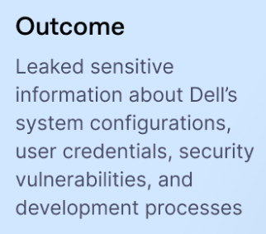
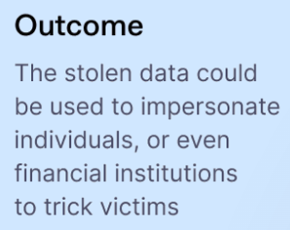
Cyber Security Data Breach in 2024
Some data breaches in 2024
Dell (impacted 49 million customers and 10,000 employees)
In May, Dell admitted losing 49 million customer records between 2017 and 2024. According to the company, the attack did not include personal or financial data but did compromise personal addresses and purchase histories.
In September, a second incident emerged. This time, hackers extracted 3.5GB of confidential employee data.
AT&T (impacted over 110 million individuals)
The first was a historical hack dating back to 2022. During a six-month window, hackers extracted call and messaging data for 110 million customers.
The other security incident emerged when 73 million customer records appeared on a data brokerage.
https://nordlayer.com/blog/data-breaches-in-2024/

Slide 4

The Hong Kong Computer Emergency Response Team Coordination Centre (HKCERT)
In 2024, HKCERT handled 12,536 security incidents, with phishing accounting for over half of all cases (7,811 cases, 62%), marking a 108% increase from 2023, with the number rising by four digits (an increase of 4,059 cases).
Malware incidents also rose significantly in 2024, increasing 4.8-fold year-over-year, with most cases involving Trojans targeting smart devices disguised as legitimate applications.
They summarized Hong Kong's cyber security landscape in 2024 and released security forecast for 2025, highlighting supply chain security and AI content hijacking will become the primary cyber security risks in Hong Kong.
https://www.hkcert.org/press-centre/hkcert-unveils-hong-kong-cyber-security-outlook-2025-phishing-hits-five-year-high-vulnerabilities-in-supply-chain-and-ai-content-hijacking-emerge-as-key-risks-over-half-of-enterprises-fear-cyber-attacks-on-iot-digital-signages

Slide 5


Traditional Security Landscape
Basic threats
Pranks (web-site defacement)
Ransom-ware
Spyware
Trojans
Backdoors/Root-kits–OS kernel
Basic delivery mechanisms
Viruses
Worms
Phishing
Software vulnerabilities
SQL-injections
Cross-Site Scripting
https://www.kaspersky.com/resource-center/threats/computer-viruses-vs-worms
Notes:
Website defacement is a type of cyber attack where malicious actors gain unauthorized access to a website and alter its content or appearance. This often involves replacing the site's legitimate content with their own messages

Slide 6
Outline
Background on Cyber Security
Future Cybersecurity Trends
AI-Driven Cyber Threats
AI-Enhanced Cyber Solutions
Discussion
Conclusion

Slide 7
Cybersecurity Trends for 2025
Gartner, Inc. has announced the top cybersecurity trends for 2025. These trends are influenced by generative AI (GenAI) evolution, digital decentralizing, supply chain interdependencies, regulatory change, endemic talent shortages and a constantly evolving threat landscape.
Gartner is a global research and advisory firm providing information and advice for leaders in many business functions including information technology, finance, human resources, customer service, communications, legal and compliance, marketing, sales, etc.
Most security efforts and financial resources are traditionally focused on protecting structured data such as databases. However, the rise of GenAI is transforming data security programs, shifting focus to protect unstructured data — such as text, images and videos.
New Trend: As AI technologies—particularly generative AI, large language models (LLMs), and autonomous agents, they are reshaping cyber threats, defenses, and the overall security paradigm.
https://www.gartner.com/en/newsroom/press-releases/2025-03-03-gartner-identifiesthe-top-cybersecurity-trends-for-2025

Slide 8
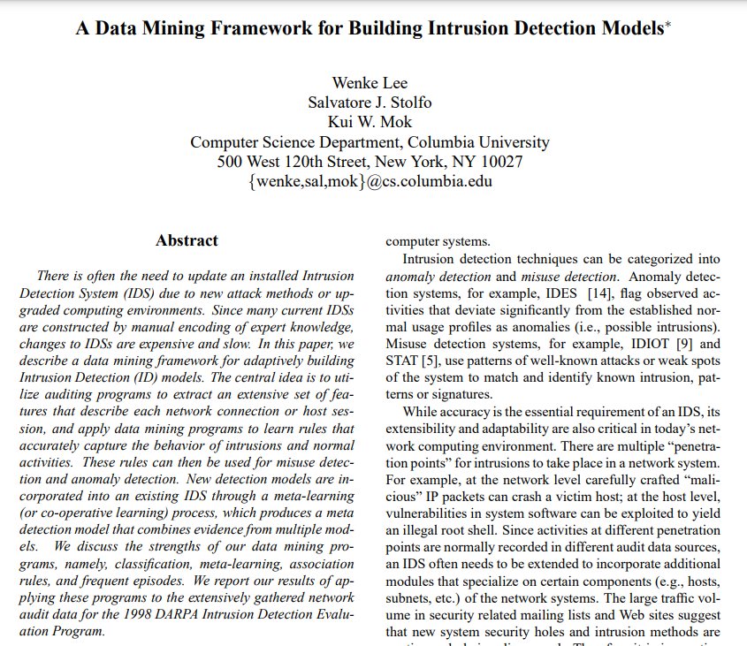
Machine Learning and AI Scope
Year of 1999
Artificial Intelligence
Simulation of human
intelligence in machines
Machine Learning
Algorithms that automate data
analysis and model building
Deep Learning
Subset of machine learning in
which multilayered neural
Networks learn from a
large amount
of data

Slide 9
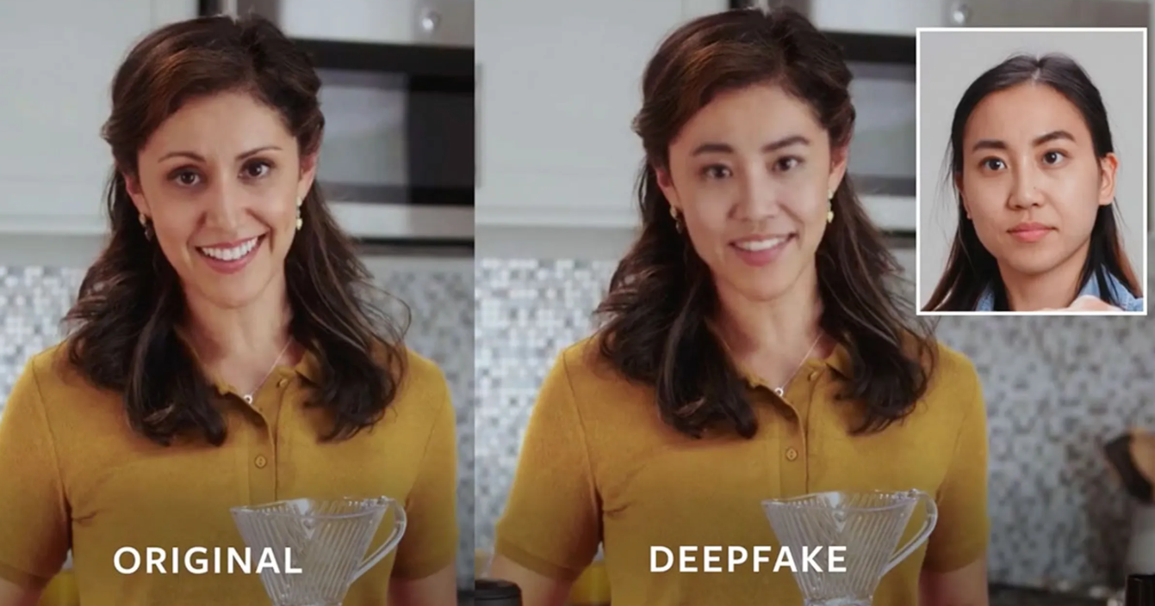
AI-Driven Cyber Threats (1)
AI-Powered Attacks:
Automated Exploitation: AI can identify vulnerabilities (e.g., in code or networks) at scale, enabling rapid, targeted attacks.
Social Engineering 2.0: Deepfake audio/video, hyper-personalized phishing (e.g., spear-phishing using LLM-generated context-aware emails).
Adaptive Malware: Malware that learns from defenses (e.g., polymorphic code that evades signature-based detection).
Adversaries can use AI to automate reconnaissance, bypass CAPTCHAs, or mimic legitimate user behavior.
https://spectrum.ieee.org/facebook-ai-launches-its-deepfake-detection-challenge

Slide 10
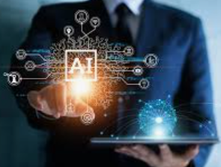
AI-Driven Cyber Threats (2)
Attacks on AI-enabled systems:
AI-Driven Disinformation: Fake content (text, images, videos) can manipulate public opinion or disrupt organizations.
Data Poisoning: Corrupting training data to manipulate AI behavior (e.g., biased or malicious outputs).
Model Evasion: Adversarial attacks can trick AI models (e.g., misclassifying malware as benign).
AI backdoor attacks are a type of adversarial attack where an attacker secretly implants malicious behavior into a machine learning (ML) model during training. The compromised model behaves normally on clean inputs but produces manipulated outputs when triggered by a specific pattern
Model Theft: Stealing proprietary AI models via inference attacks.

Slide 11
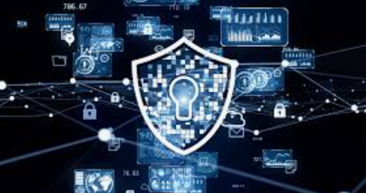

Traditional Network Security Mechanisms
Firewalls
Security Perimeter Control
Network Segmentation/Segregation
Anti-Virus Software (AVS, virus checkers)
Signature based
Signatures must be updated regularly
Intrusion Detection/Prevention Systems (IDS/IPS)
Host based
Typically based on log analysis
Reactive, mostly performed after discovering incidents
Network based
Rule-based
Anomaly-detection

Slide 12
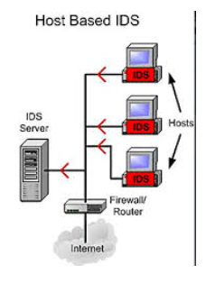
IDS Types (Mature, Basic but Important Security Technique)
Host Based Systems
Inspects local information
Application log-files
System log-files
etc.
Network Based Systems
Inspects traffic on the network
Network Events
Signature Based Detection Systems
Relies on established patterns (“signatures”) in malicious network traffic
Similar to the signatures used in virus checkers
Anomaly-Based Detection Systems
Establishes base line for normal communication
Detects abnormal traffic pattern
Employs techniques from machine learning, pattern matching, big data

Slide 13

AI-Enhanced Cyber Solutions
AI-enhanced Security:
Accuracy. AI models can help improve the detection accuracy of existing security tools, e.g., intrusion detection systems, firewalls.
Efficiency. AI can help analyze many datasets (incl. logs, network traffic) to detect anomalies in real time (e.g., UEBA—User and Entity Behavior Analytics).
Automation. AI-driven SOAR (Security Orchestration, Automation, and Response) automates incident response (e.g., isolating infected systems). Self-healing systems can patch vulnerabilities.
Novel attack identification. AI can facilitate predictive analytics flag zero-day exploits by identifying unusual patterns.
Advanced Use of Generative AI :
Simulating cyberattacks (e.g., with AI-generated attack scenarios).
Generating synthetic training data for detection models.

Slide 14
Outline
Background on Cyber Security
Future Cybersecurity Trends
AI-Driven Cyber Threats
AI-Enhanced Cyber Solutions
Discussion
Conclusion

Slide 15
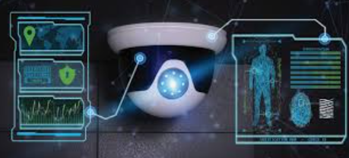
Emerging and Open Challenges on AI in Security
Explainability and Trust: Black-box AI models (e.g., deep learning) may make unexplainable security decisions.
Bias and Fairness: Flawed training data can lead to discriminatory or ineffective security policies.
Regulation and Compliance: Governments struggle to regulate dual-use AI (e.g., the EU AI Act, NIST AI RMF).
For students, how to use AI in their studies?
Supply Chain Risks: Third-party AI tools (e.g., ChatGPT plugins) introduce new attack surfaces.
Notes:
Key Features:
Risk-Based Classification:
Unacceptable Risk (e.g., social scoring, predictive policing) → Banned.
High Risk (e.g., medical devices, critical infrastructure) → Mandatory compliance (data governance, transparency, human oversight).
Limited Risk (e.g., chatbots) → Transparency obligations (e.g., disclose AI use).
Minimal Risk (e.g., spam filters) → No restrictions.
Requirements for High-Risk AI:
Conformity assessments, logging, cybersecurity, and fundamental rights impact assessments.
General-Purpose AI (GPAI) models (e.g., ChatGPT) must meet transparency and copyright standards.
Enforcement:
Fines up to €35M or 7% of global revenue for violations.
Phased implementation (2024–2026).
Goal: Balance innovation with ethical AI use, protecting EU citizens’ rights

Slide 16

Potential Countermeasures
AI Security Frameworks: Adopt guidelines to help establish security protection, such as NIST AI Risk Management Framework (RMF), MITRE ATLAS.
Third-Party AI Audits: Ensure AI vendors to log events for security risk analysis (e.g., backdoors in pre-trained models).
Red Teaming AI Systems: Simulate AI-powered attacks to test defenses.
Homomorphic Encryption (HE): Allows AI to process encrypted data without decryption.
Blockchain for AI Integrity: Ensures tamper-proof AI model deployments.
Continuous Education and Training: Educate staff on AI-driven threats (e.g., deepfake threats).

Slide 17
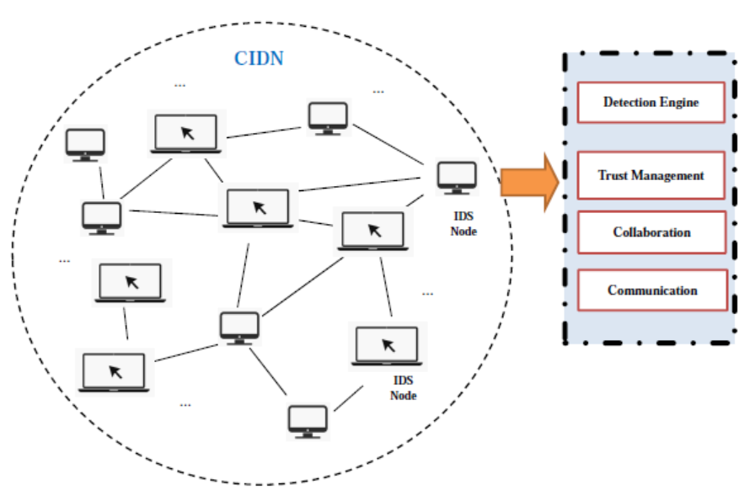
Case: CIDN framework with major components
Detection engine. Similar to a single IDS, detection engine here can employ both signature-based and anomaly-based detection to help examine incoming events.
Trust management. Help build the trust relationship among various nodes and identify malicious nodes.
Collaboration. This component is used to help coordinate the information exchange among different nodes.
Communication. This component is mainly responsible for building physical connections with different nodes.
W. Li and W. Meng. Collaborative intrusion detection in the era of IoT: Recent Advances and Challenges. Security and Privacy in the Internet of Things: Architectures, Techniques, and Applications (Book), Wiley-IEE, 2021.

Slide 18
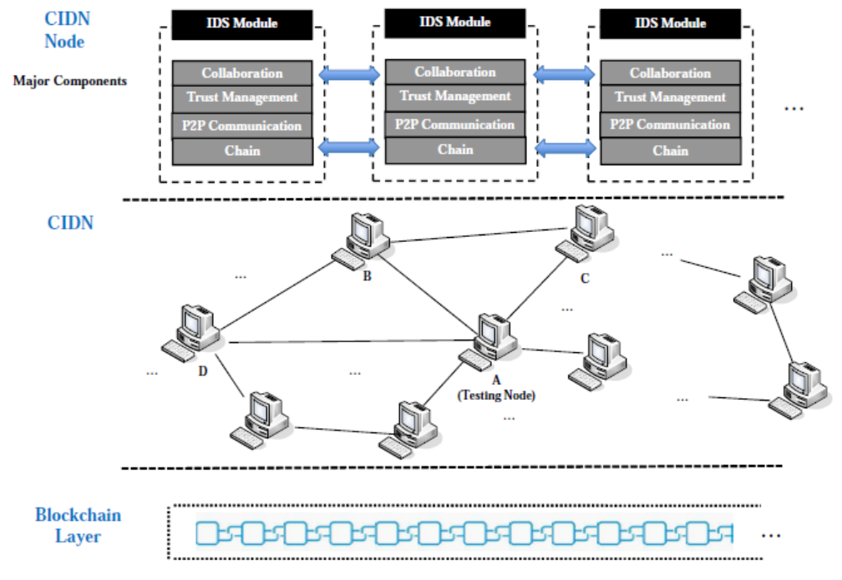
Case: Blockchain with ML/AI-based CIDS
Blockchain Layer:
This layer makes the framework different from traditional CIDN architectures, through allowing to establish a consortium blockchain.
To verify ML model / events / messages via blockchain.

Slide 19
Future Trend and Topics -- Gartner
1. Managing Machine Identities
Increasing adoption of GenAI, cloud services, automation and DevOps practices, has led to the prolific use of machine accounts and credentials for physical devices and software workloads.
2. Tactical AI
Security and risk management leaders are facing mixed results with their AI implementations, leading them to reprioritize their initiatives and focus on narrower use cases with direct measurable impacts.
3. Cybersecurity Technology Optimization
According to a Gartner survey of 162 large enterprises, conducted between August and October 2024, organizations use an average of 45 cybersecurity tools. With over 3,000 vendors in cybersecurity, SRM leaders need to optimize their toolsets to build more efficient and effective security programs.
https://www.gartner.com/en/newsroom/press-releases/2025-03-03-gartner-identifiesthe-top-cybersecurity-trends-for-2025

Slide 20
Outline
Background on Cyber Security
Future Cybersecurity Trends
AI-Driven Cyber Threats
AI-Enhanced Cyber Solutions
Discussion
Conclusion

Slide 21

Take Away Key Points
The future of cybersecurity will be a dynamic battleground where AI is a key technology.
Cyber attackers can use AI to automate the traditional attacking ways and quickly detect potential vulnerabilities in a system or network.
Security response team can use AI to enhance the detection performance of existing security tools and automate the detection process (e.g., self-healing systems).
To build an AI-resilient security defence, we can consider the followings:
Deploy AI-powered detection.
Secure AI models.
Automate responses (e.g., self-healing systems).
Adopt governance frameworks (NIST AI RMF, MITRE ATLAS).
User education (e.g., constructing a secure environment).

Slide 22



