Slide 1

Nurturing a Growth Mindset:
Empowering English Language Educators with Scalable Tasks and Engaging Activities through Generative AI
Ricky Kwok

Slide 2
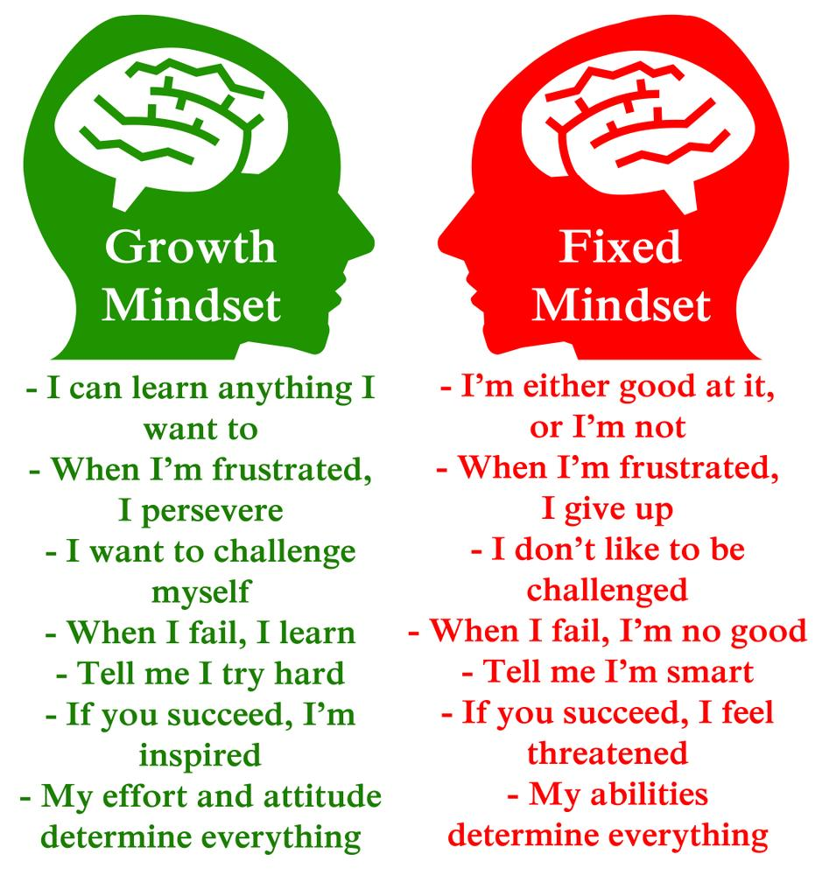
Notes:
The FIRST learning outcome!

Slide 3

Language is a tool to express oneself
A construction process
  Rules
  Varieties
  Ingredients
  Connections
Growth…

Slide 4

From an English Learner’s Vantage Point
Difficulties:
  Pick up vocabulary
  (spelling, recognition/reading)
  Accurate pronunciation
  Usage of vocabulary (choice of words)
  Usage of grammar and
  sentence structures
  Composition
  Really learned something?
Not integrated (or aligned)?
  Reading, Writing, Speaking, Listening
Homework: leveraging family support more effectively (book reading buddy? Learning by teaching [parents]?)
Growth… Expanding expressiveness? Cultivated as a lifelong learner?

Slide 5

On the Teacher’s Side…
Accordingly, teacher’s pain points:
  Contents: more? Scale up/down?
  Customization?
  Marking composition: quantity!
  Rubrics?
  Data about students’ learning progress?
  Incentives (externality) to motivate students to do more?
  All in all, teachers are overwhelmed with a multitude of tasks (e.g., dictation, grammar, etc.) on a daily basis;
Bottomline: Coverage
Dream: An easier integrated workflow with holistic data?
Growth… Expanding pedagogy with AI tools? Each student gets precise help?

Slide 6

Open English
Open Textbook Project
(2016)
EDB QEF: Modernizing Open Textbook (2023)
  A comprehensive platform as textbook (PAT)
  Generative AI
https://www.opentextbooks.org.hk/

Slide 7
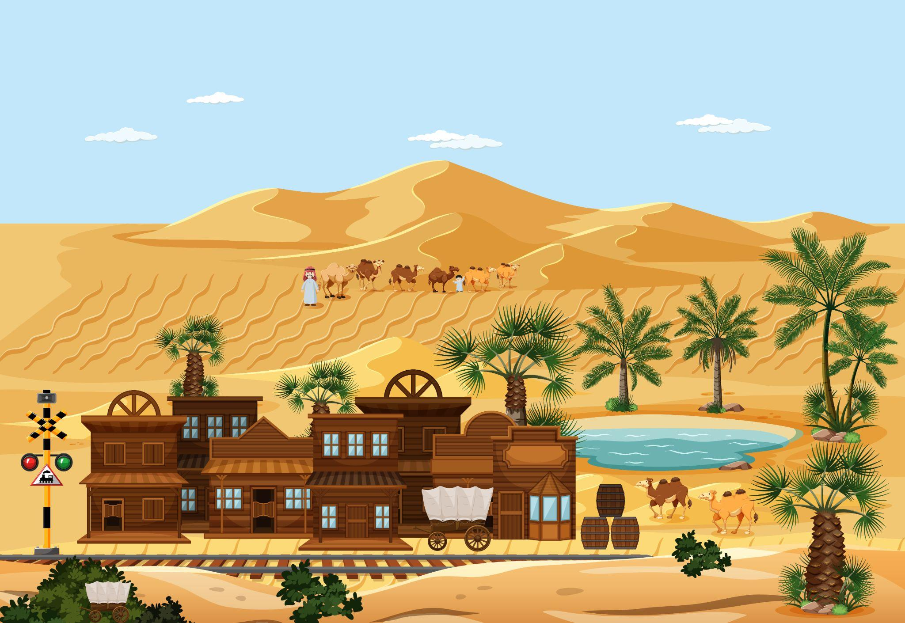
Our Platform: Oasis
Oasis’s Design Goals: STACI
  Scalable
  Task Oriented
  Accountable
  Customizable
  Integration
Empower teachers with:
  Breadth: scalable, customizable contents, more tasks!
  Depth: drilled deeper (for some students) based on accountability (data!), integrated all four skills

Slide 8

Oasis: Some AI-Powered Features…
Vocabulary: games, dictation, …
Read aloud
Book reading buddy
Composition marking
Scale up/down article
Uploading own articles
Analytics
Completely integrated!
etc.

Slide 9
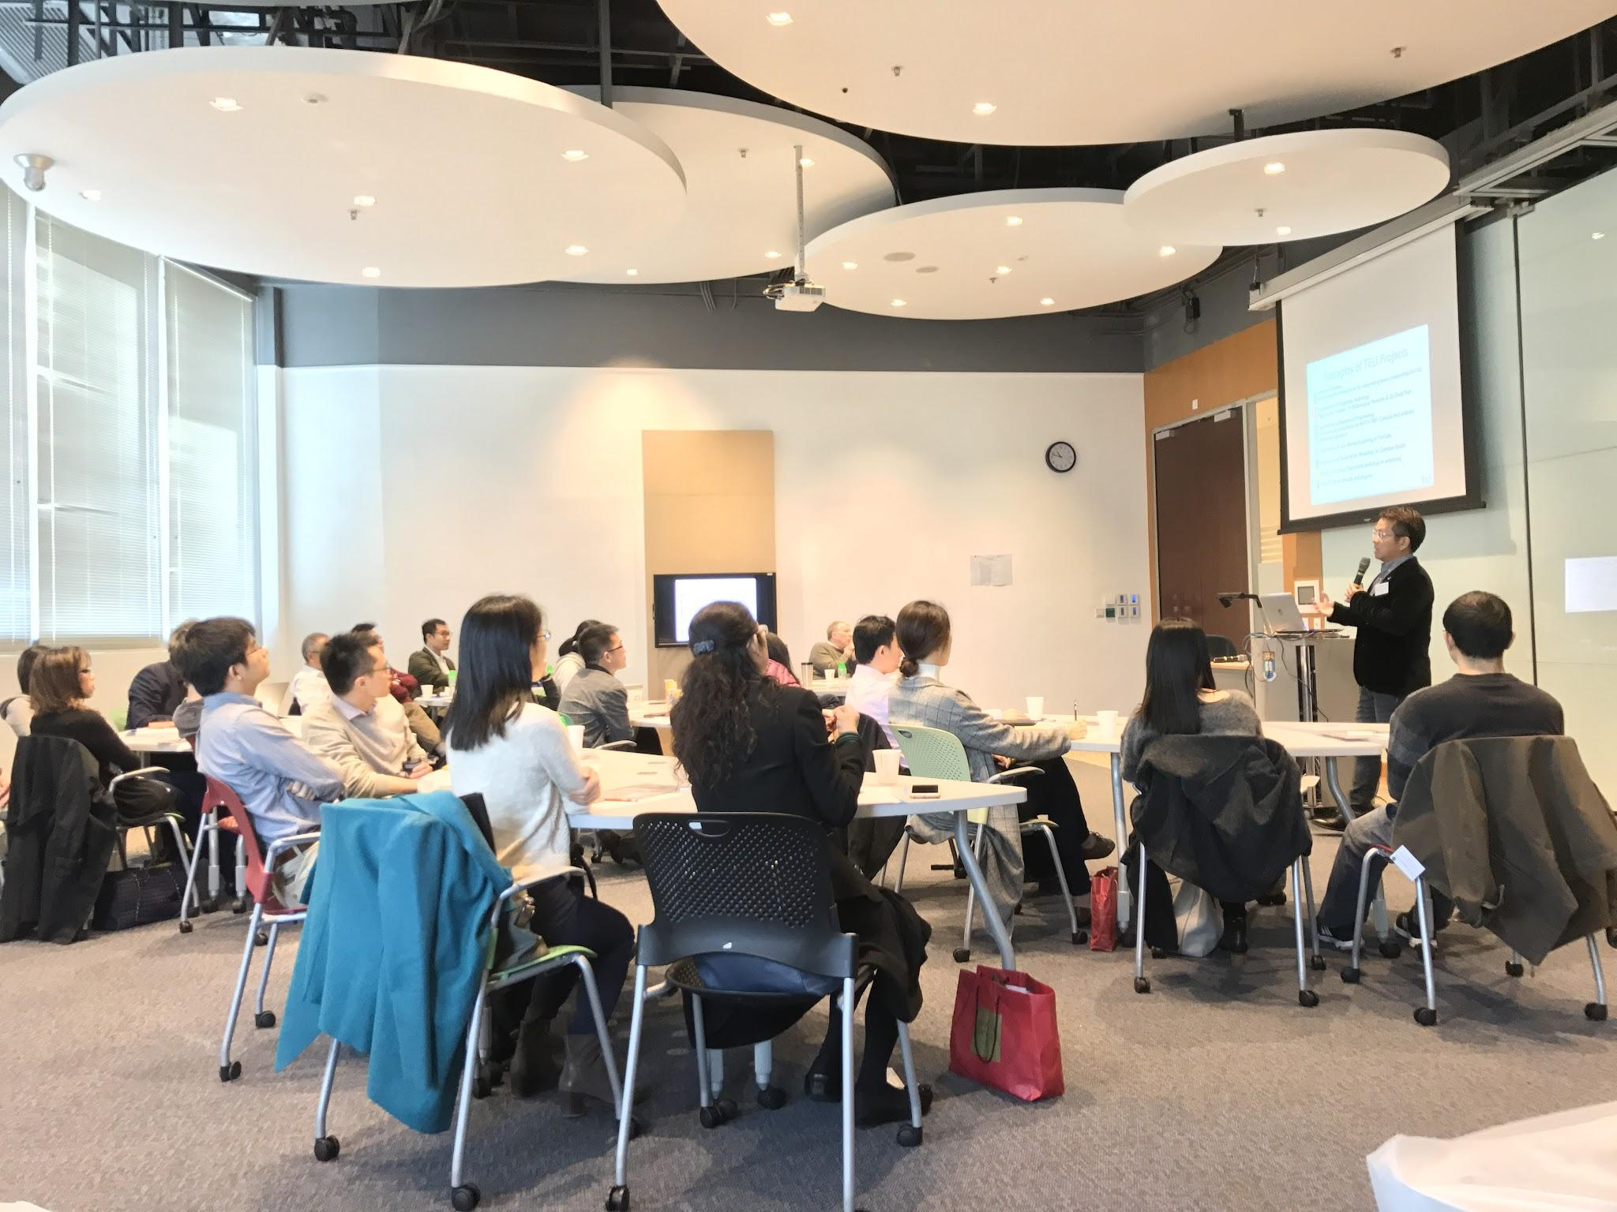
THANKS!
Slide URL: bit.ly/LTE-20250702
Happy to further discuss
Email me at kwok@hkmu.edu.hk
Notes:
Thank you very much!

