Slide 1



Trends in International Mathematics and Science Study (TIMSS)
The Hong Kong Centre for IEA Studies
Faculty of Education
The University of Hong Kong

Slide 2

Background of TIMSS
by
Professor Frederick Leung

Slide 3
Background of TIMSS
TIMSS is conducted under the auspices of the International Association for the Evaluation of Educational Achievement (IEA)
TIMSS is the largest international study of mathematics and science education in the history of comparative studies
IEA considers the processes and effects of education and studies the linkages between
→ intended curriculum (what policy requires)
→ implemented curriculum (what is taught in school)
→ attained curriculum (what students learn)

Slide 4
Background of TIMSS
It probes into different factors that account for student achievement through a set of questionnaires
The Hong Kong study have provided data enabling characteristics of the students, teachers and schools to be described and also enabling differences in mathematics and science achievement of students to be explained
Hong Kong participated in TIMSS 1995, 1999, 2003, 2007 and 2011
In TIMSS 2011, over 600,000 Primary 4 and Secondary 2 students from 63 countries/regions and 14 benchmarking entities* participated in the study
TIMSS 2015 is the 6th cycle of the study
*Benchmarking entities are regional jurisdictions of countries

Slide 5
Previous Cycles of TIMSS
1995 : Third International Mathematics and Science Study (TIMSS)
→ Tested students at P.3, P.4, S.1, S.2, and S.6
1999 : Third International Mathematics and Science Study – Repeat (TIMSS-R)
→ Tested students at S.2
2003 - 2011: Trends in International Mathematics and Science Study (TIMSS)
→ Tested students at P.4 and S.2

Slide 6
Content and Cognitive Domains Tested in TIMSS
Content Domains
Primary 4
Mathematics: Number, Geometric Shapes and Measures, Data Display
Science: Life Science, Physical Science, Earth Science
Secondary 2
Mathematics: Number, Algebra, Geometry, Data and Chance
Science: Biology, Physics, Chemistry, Earth Science
Cognitive Domains
Primary 4 and Secondary 2
Knowing, Applying, Reasoning

Slide 7
How well did HK perform in international settings?

Slide 8
TIMSS 2011 & Trend Findings
in
Mathematics

Slide 9
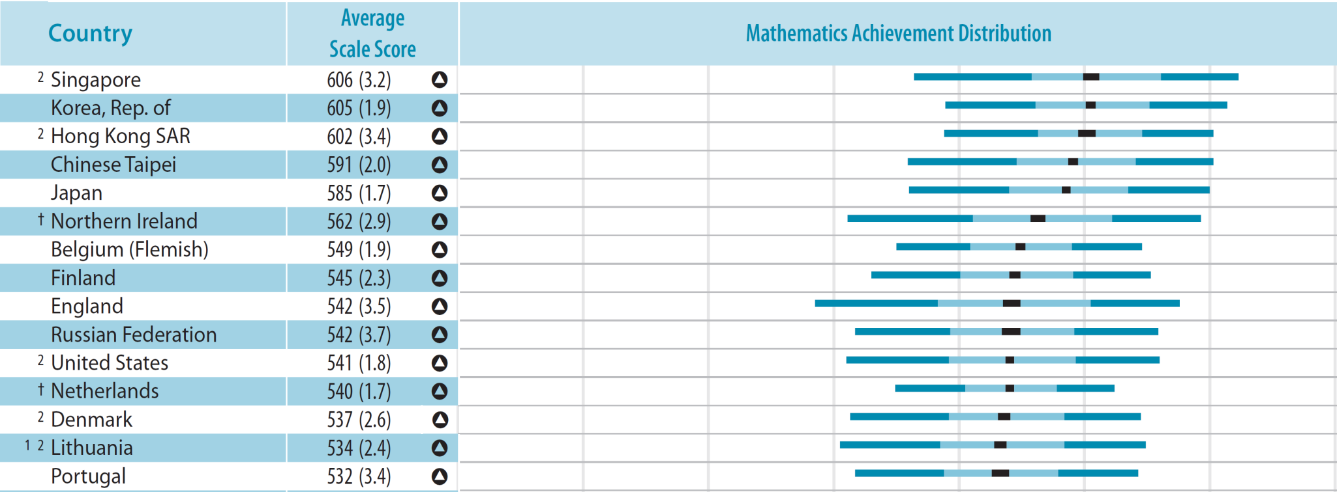
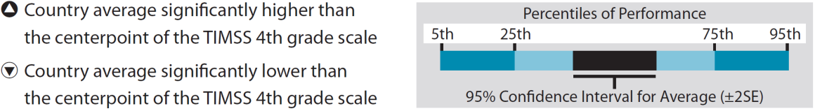
Results – Mathematics Achievement
Primary 4
1st − 3rd
3rd
4th
5th
6th
*First 15 countries

Slide 10
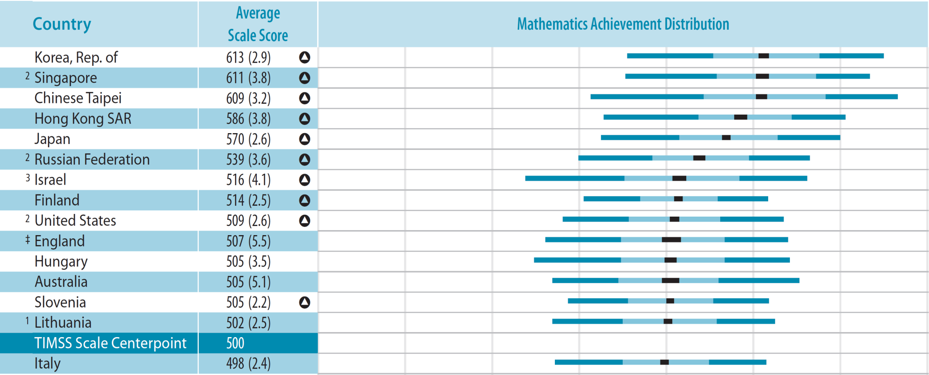
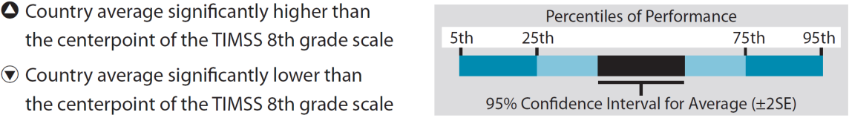
Results – Mathematics Achievement
Secondary 2
1st − 3rd
4th
5th
6th
*First 15 countries

Slide 11
Trends in HK Mathematics Achievement
Primary 4
Year | Avg. Scale Score | 2007 to 2011 Difference | 2003 to 2011 Difference | 1995 to 2011 Difference
2011 | 602 (3.4)
2007 | 607 (3.6) | -5
2003 | 575 (3.2) |  | 27^
1995 | 557 (4.0) |  |  | 45^
^ 2011 average significantly higher

Slide 12
Trends in HK Mathematics Achievement
Secondary 2
Year | Avg. Scale Score | 2007 to 2011 Difference | 2003 to 2011 Difference | 1999 to 2011 Difference | 1995 to 2011 Difference
2011 | 586 (3.8)
2007 | 572 (5.8) | 13
2003 | 586 (3.3) |  | 0
1999 | 582 (4.3) |  |  | 4
1995 | 569 (6.1) |  |  |  | 17^
^ 2011 average significantly higher

Slide 13
Achievement in Mathematics Content Domain Areas
Primary 4
Year | Number | Geometric Shapes and Measures | Data Display
2011 | 604 | 605 | 593
2007 | 608 | 613 | 600
Secondary 2
Year | Number | Algebra | Geometry | Data and Chance
2011 | 588 | 583 | 597 | 581
2007 | 575 | 575 | 580 | 560

Slide 14
Achievement in Mathematics Cognitive Domain Areas
Primary 4
Year | Knowing | Applying | Reasoning
2011 | 619 | 597 | 589
2007 | 622 | 606 | 596
Secondary 2
Year | Knowing | Applying | Reasoning
2011 | 591 | 587 | 580
2007 | 583 | 572 | 567

Slide 15
International Benchmarks of Mathematics Achievement
Four levels
Advanced (625)
High (550)
Intermediate (475)
Low (400)
Students at each international benchmark should be able to answer the questions belong to the corresponding benchmark correctly
Students achieving higher benchmark can better apply their understanding and awareness in solving more complex problems than those at lower benchmark

Slide 16
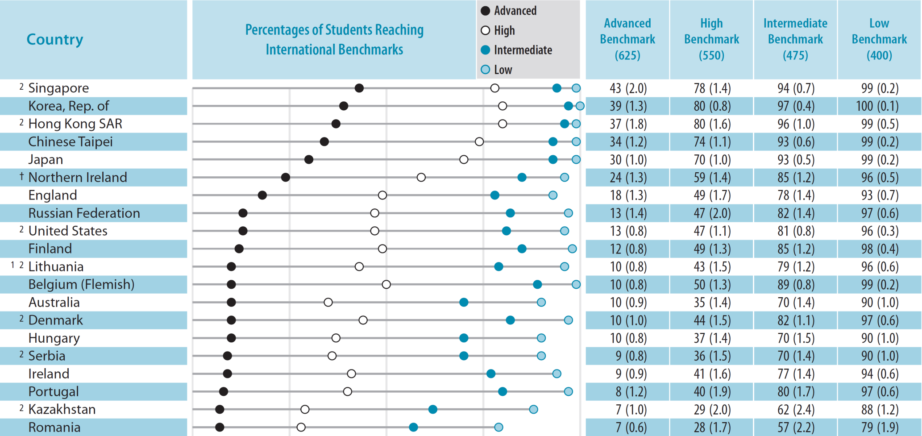
International Benchmarks of Mathematics Achievement in 2011
Primary 4
*First 20 countries

Slide 17
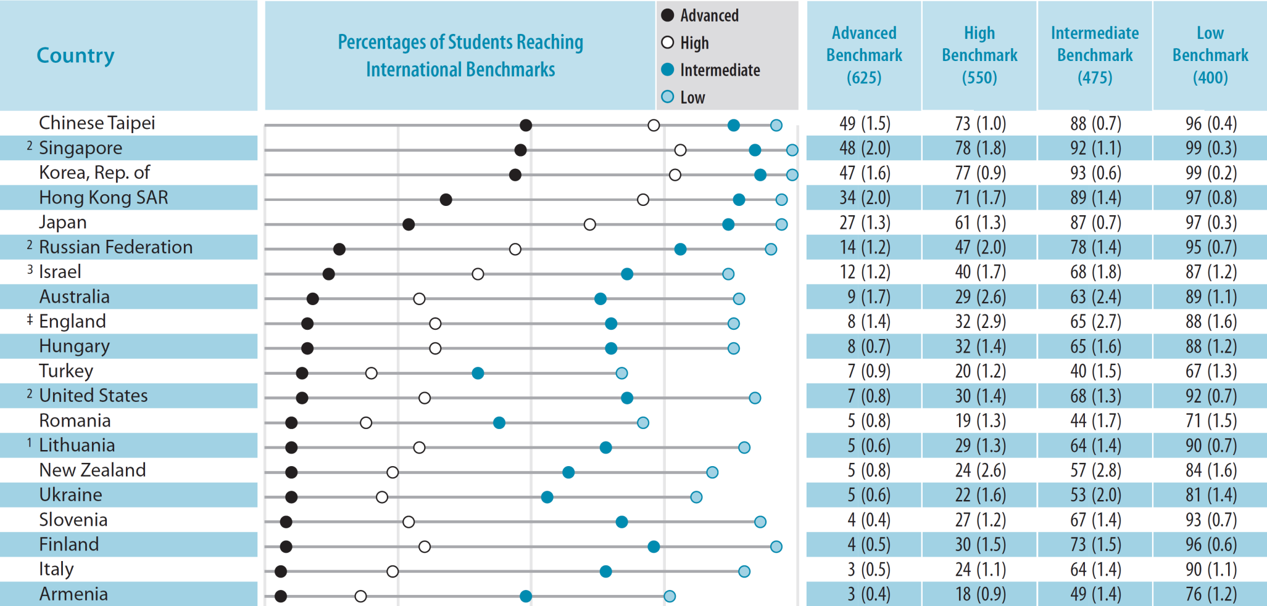
International Benchmark of Mathematics Achievement in 2011
Secondary 2
*First 20 countries

Slide 18
Trends in Percentages of Students Reaching the Advanced Benchmark
Primary 4
Year | Advanced | High | Intermediate | Low
2011 | 37% | 80% | 96% | 99%
2007 | 40% | 81% | 97% | 100%
2003 | 22%^ | 67%^ | 94%^ | 99%
1995 | 17%^ | 56%^ | 87%^ | 97%^
^ 2011 average significantly higher

Slide 19
Trends in Percentages of Students Reaching the Advanced Benchmark
Secondary 2
Year | Advanced | High | Intermediate | Low
2011 | 34% | 71% | 89% | 97%
2007 | 31% | 64%^ | 85% | 94%
2003 | 31% | 73% | 93% | 98%
1999 | 28%^ | 70% | 92% | 98%
1995 | 23%^ | 65% | 88% | 96%
^ 2011 average significantly higher

Slide 20
TIMSS 2011 & Trend Findings
in
Science

Slide 21
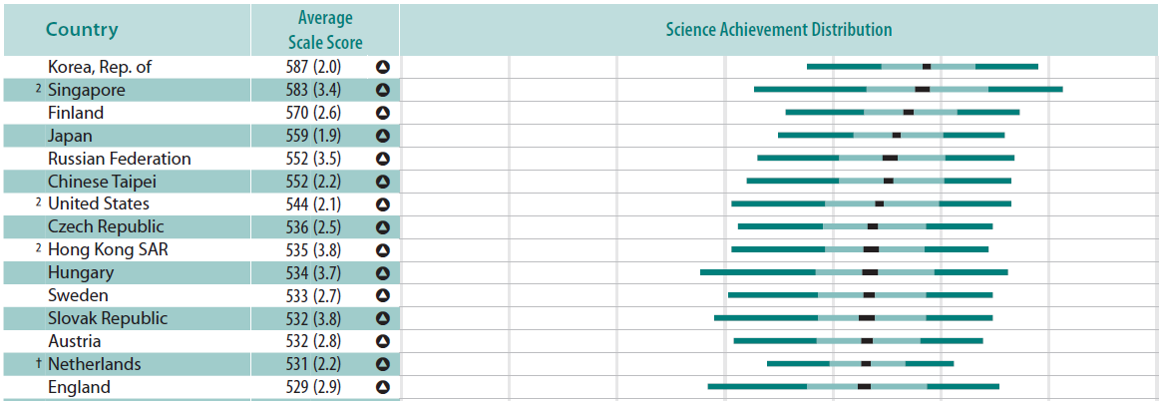
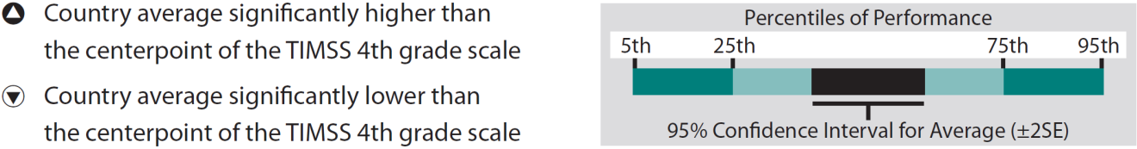
Results – Science Achievement
Primary 4
1st − 2nd
3rd
4th − 6th
7th
8th − 14th
*First 15 countries

Slide 22
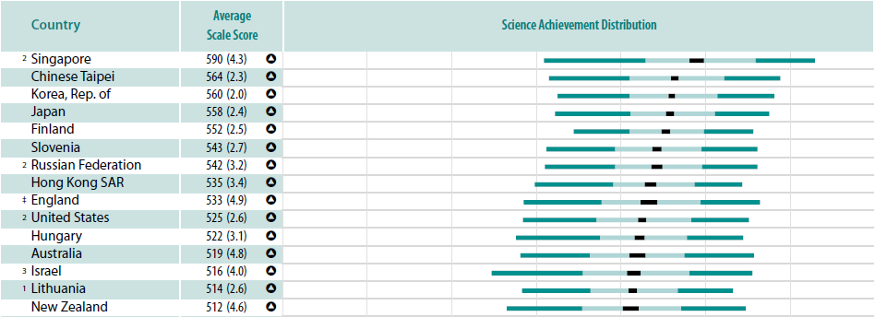
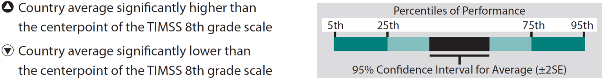
Results – Science Achievement
Secondary 2
1st
2nd − 4th
5th− 9th
*First 15 countries

Slide 23
Trends in HK Science Achievement
Primary 4
Year | Avg. Scale Score | 2007 to 2011 Difference | 2003 to 2011 Difference | 1995 to 2011 Difference
2011 | 535 (3.8)
2007 | 554 (3.5) | -19*
2003 | 542 (3.1) |  | -8
1995 | 508 (3.3) |  |  | 27^
^ 2011 average significantly higher
* 2011 average significantly lower

Slide 24
Trends in HK Science Achievement
Secondary 2
Year | Avg. Scale Score | 2007 to 2011 Difference | 2003 to 2011 Difference | 1999 to 2011 Difference | 1995 to 2011 Difference
2011 | 535 (3.4)
2007 | 530 (4.9) | 5
2003 | 556 (3.0) |  | -21*
1999 | 530 (3.7) |  |  | 6
1995 | 510 (5.8) |  |  |  | 25^
^ 2011 average significantly higher
* 2011 average significantly lower

Slide 25
Achievement in Science Content Domain Areas
Primary 4
Year | Life Science | Physical Science | Earth Science
2011 | 524 | 539 | 548
2007 | 540 | 562 | 568
Secondary 2
Year | Biology | Chemistry | Physics | Earth Science
2011 | 535 | 526 | 539 | 539
2007 | 529 | 521 | 530 | 535

Slide 26
Achievement in Science Cognitive Domain Areas
Primary 4
Year | Knowing | Applying | Reasoning
2011 | 537 | 529 | 541
2007 | 553 | 552 | 563
Secondary 2
Year | Knowing | Applying | Reasoning
2011 | 544 | 529 | 538
2007 | 537 | 522 | 535

Slide 27
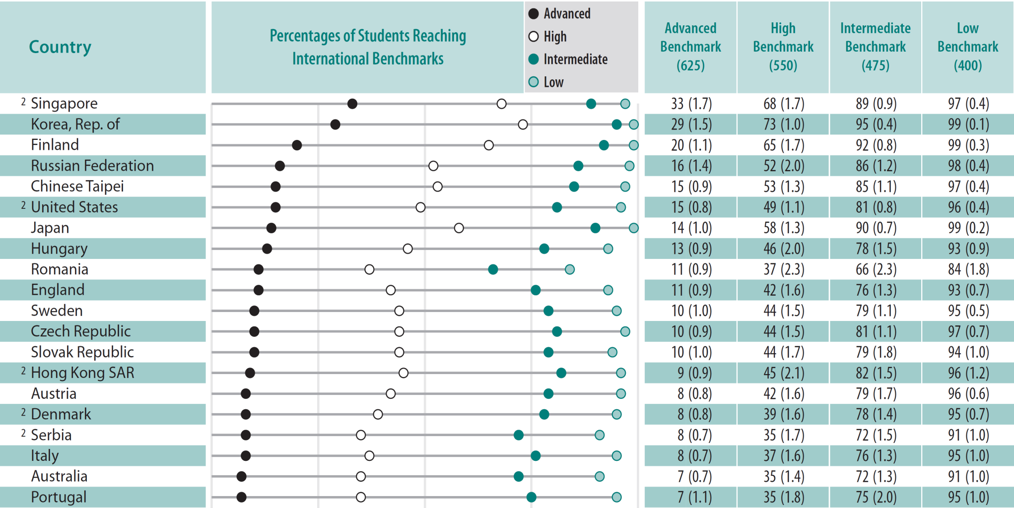
International Benchmarks of Science Achievement in 2011
Primary 4
*First 20 countries

Slide 28
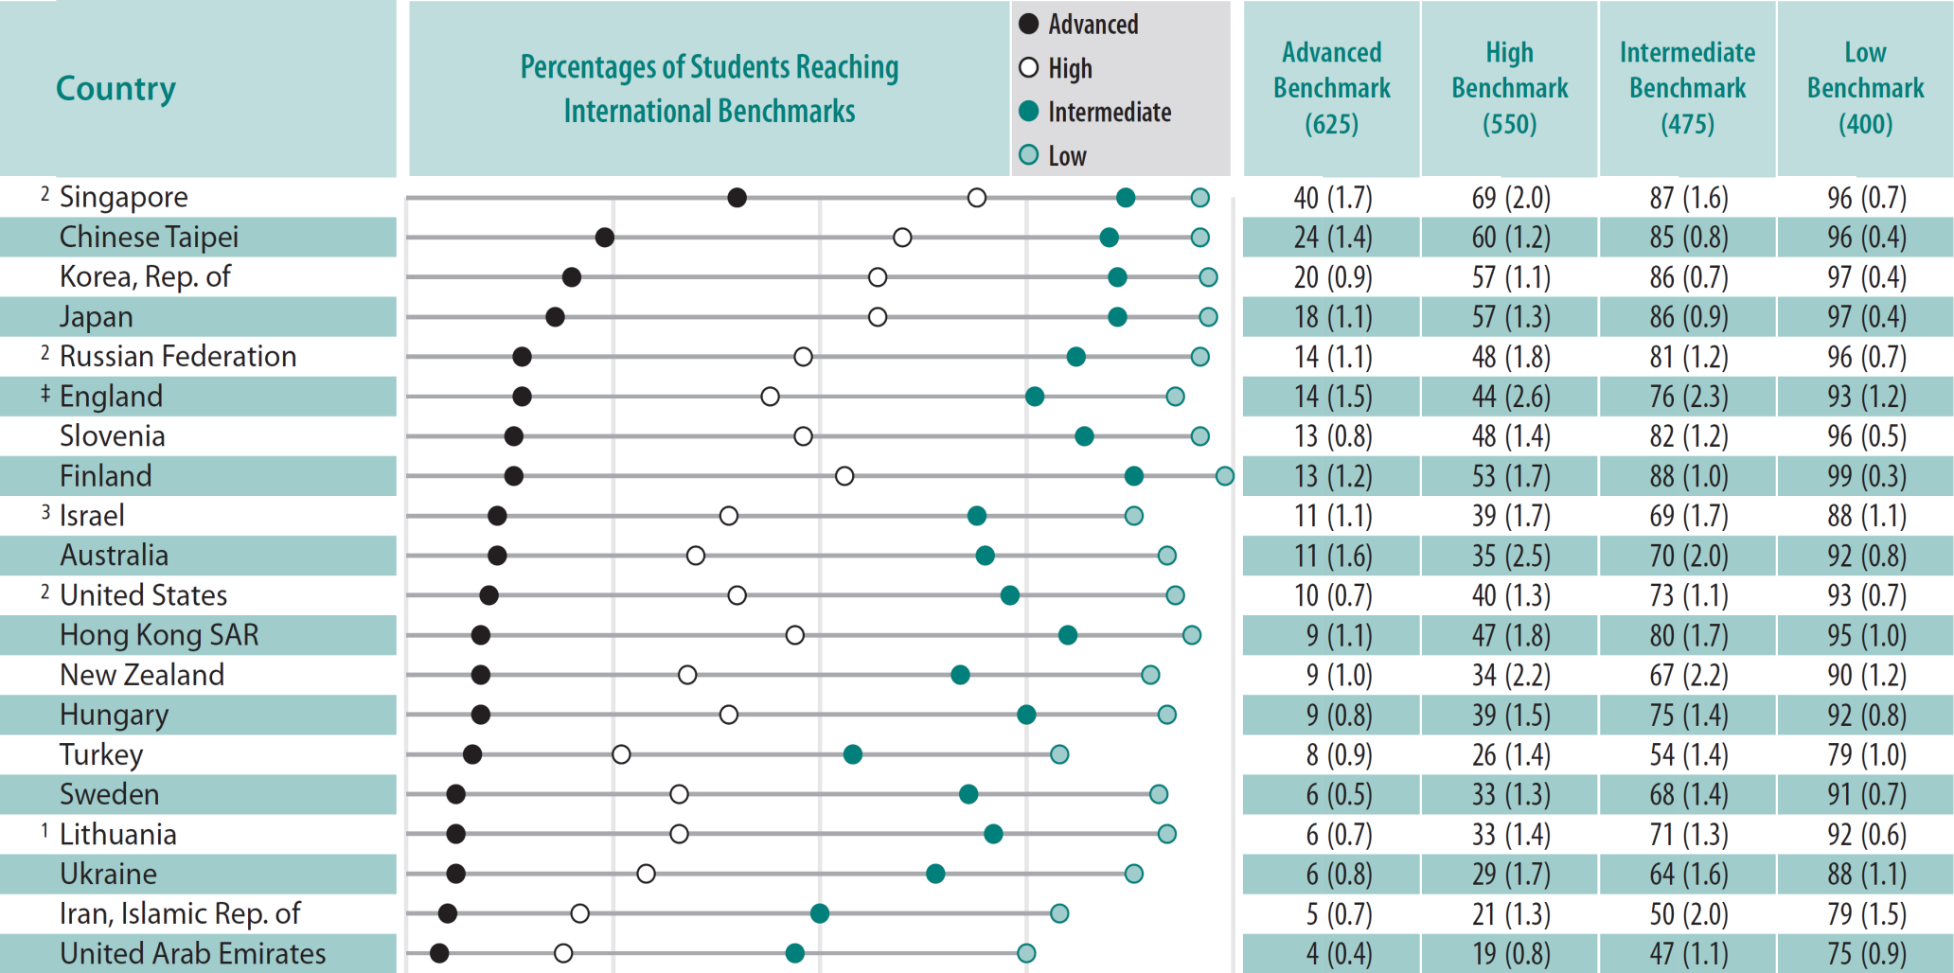
International Benchmarks of Science Achievement in 2011
Secondary 2
*First 20 countries

Slide 29
Trends in Percentages of Students Reaching the Advanced Benchmark
Primary 4
Year | Advanced | High | Intermediate | Low
2011 | 9% | 45% | 82% | 96%
2007 | 14%* | 55%* | 88%* | 98%
2003 | 7% | 47% | 87%* | 98%*
1995 | 5%^ | 30%^ | 69%^ | 91%^
^ 2011 average significantly higher
* 2011 average significantly lower

Slide 30
Trends in Percentages of Students Reaching the Advanced Benchmark
Secondary 2
Year | Advanced | High | Intermediate | Low
2011 | 9% | 47% | 80% | 95%
2007 | 10% | 45% | 77% | 92%
2003 | 13%* | 58%* | 89%* | 98%*
1999 | 7% | 40%^ | 80% | 96%
1995 | 7% | 33%^ | 70%^ | 90%^
^ 2011 average significantly higher
* 2011 average significantly lower

Slide 31
The Use of TIMSS Results
in
Hong Kong

Slide 32
The Use of TIMSS Results in Hong Kong
In every cycle of TIMSS, a series of workshops and seminars are given to teachers, government officials, curriculum staff, etc., to inform about the current situations of our students (e.g. strengths, weaknesses/misconceptions, beliefs, attitudes, etc.) and issues concerning the curriculum (e.g. content coverage)
Specifically, recommendations on learning and teaching strategies for addressing students' weaknesses are made during the teacher workshops

Slide 33
The Use of TIMSS Results in Hong Kong
National reports on different cycles of TIMSS are produced
At the school level, an individual school report informing student achievement of the testing class(es) is given to every participating school to help schools and teachers to have a better understanding of their students’ needs in different areas of mathematics and science

Slide 34
The Use of TIMSS Results in Hong Kong
There are also a number of projects which are based on a secondary analysis of the TIMSS data and/or inspired by the TIMSS findings
(e.g. An on-going project: Promoting assessment for learning in junior secondary science through identifying students' learning difficulties from secondary analysis of TIMSS and refining classroom learning and teaching practices)
The results of these studies have provided insights about teaching and learning in our schools

Slide 35
The Use of TIMSS Results in Hong Kong
Furthermore, with the publication and dissemination of results of earlier phases of Hong Kong component of TIMSS, impact has been made on the mathematics and science education community and on the curriculum development process
- Copies → every school in HK
→ government agencies for curriculum development
→Faculties of Education in tertiary institutions

Slide 36
The Use of TIMSS Results in Hong Kong
For example, prompted by the results of earlier phases of the study, the then Education Department commissioned the Project Team Leader to lead a team of researchers to draw implications of TIMSS and other international studies for mathematics curriculum development in Hong Kong
The report of that study has direct bearing on the new mathematics curriculum issued 1999

Slide 37
How TIMSS Informs about Learning and Teaching, and Curriculum Development?
The Case for Science Education
in HK
by
Dr. Alice Wong

